Slide 1
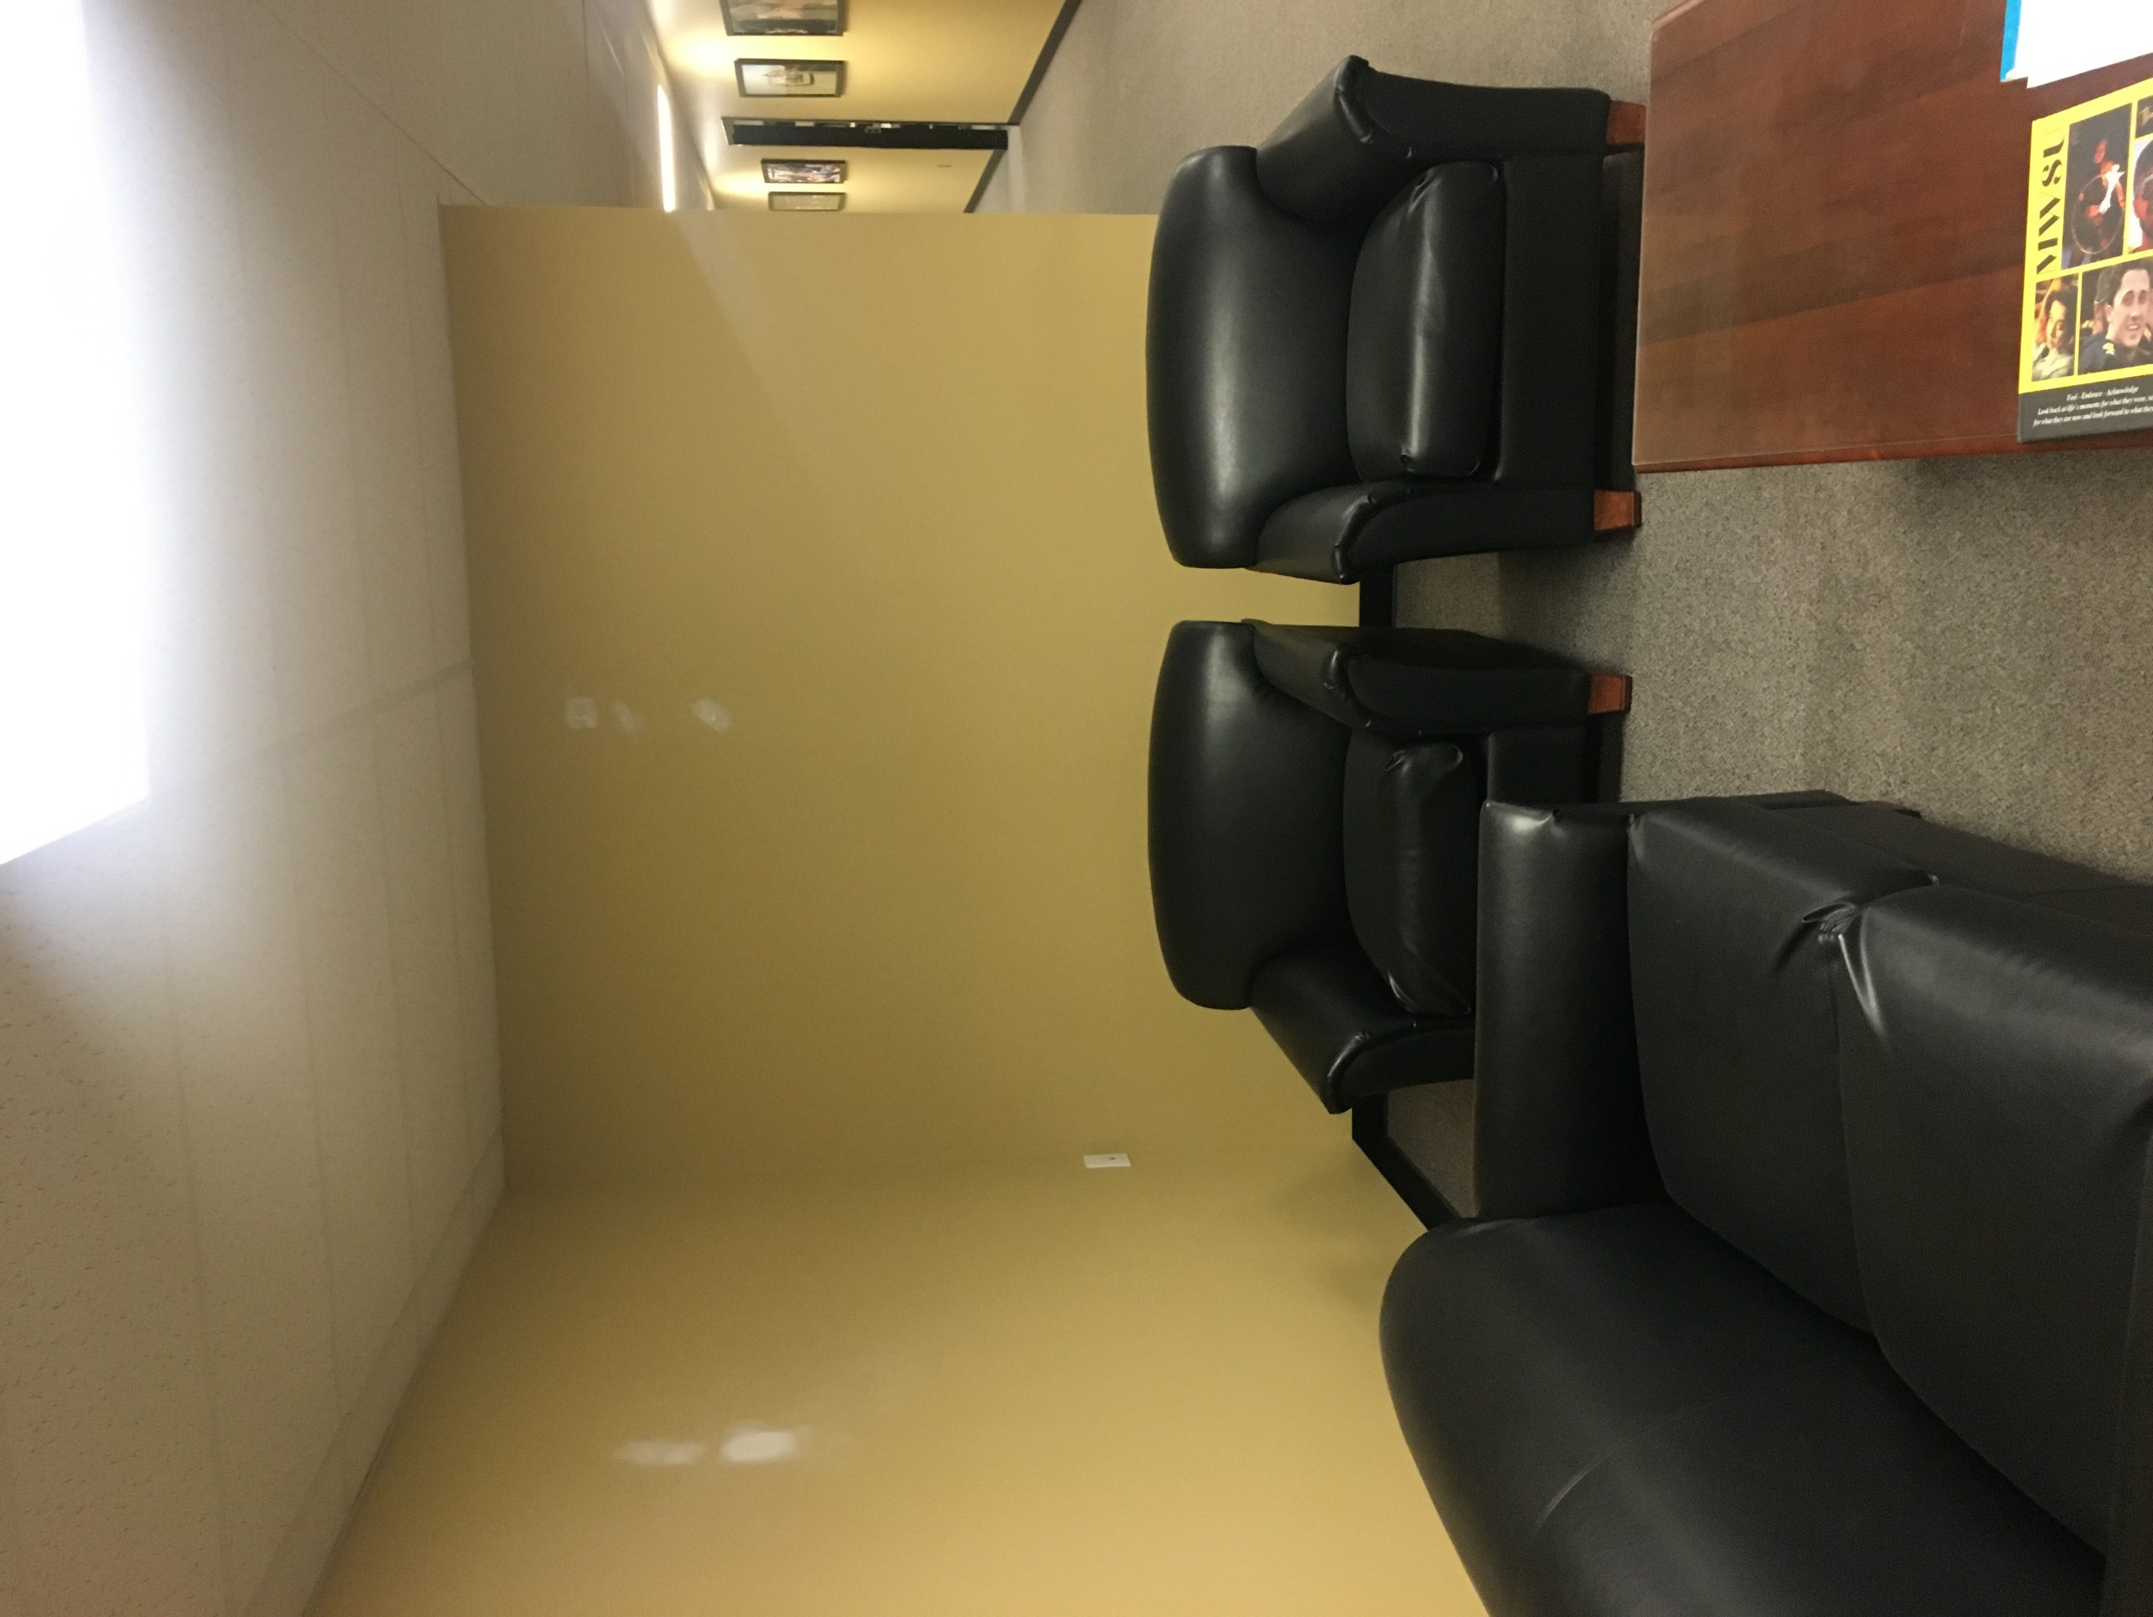
Wall #1 Photo Wall. East Wall Only
Width 99 Inches
Height 91.5 Inches
Please note, no outlet covers or light switches will be covered with vinyl on any of the projects

Slide 2
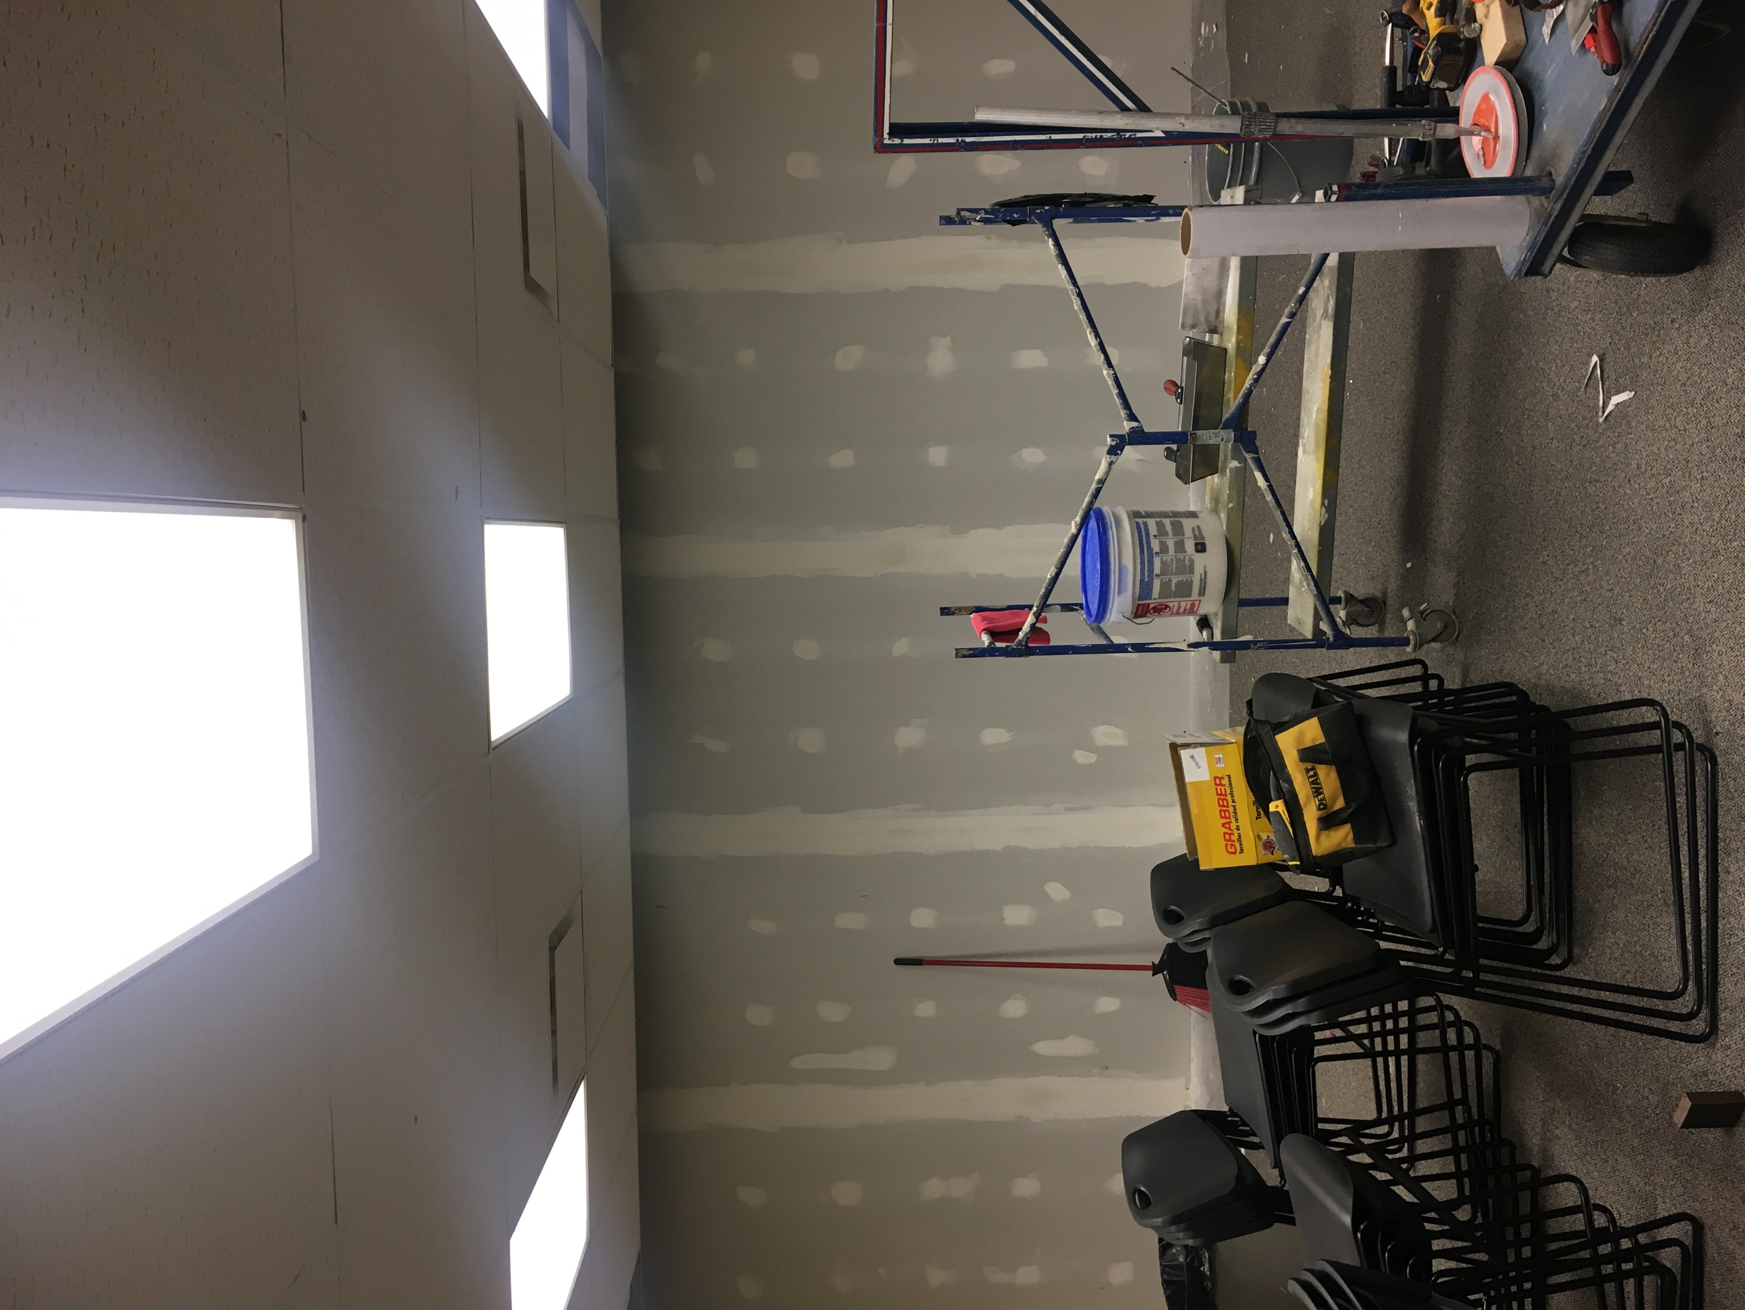
Wall #2 North Wall new sheetrock over existing cement block
Width 273.5 inches
Height 91.5 Inches

Slide 3
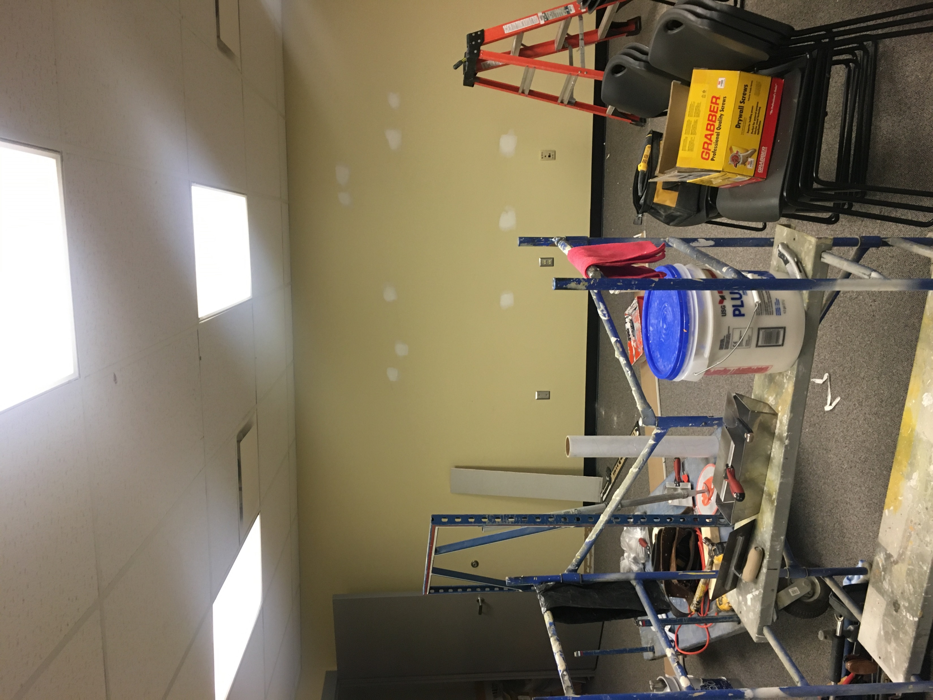
Wall #3 South Wall
Width 254 Inches
Height 91.75 Inches

Slide 4
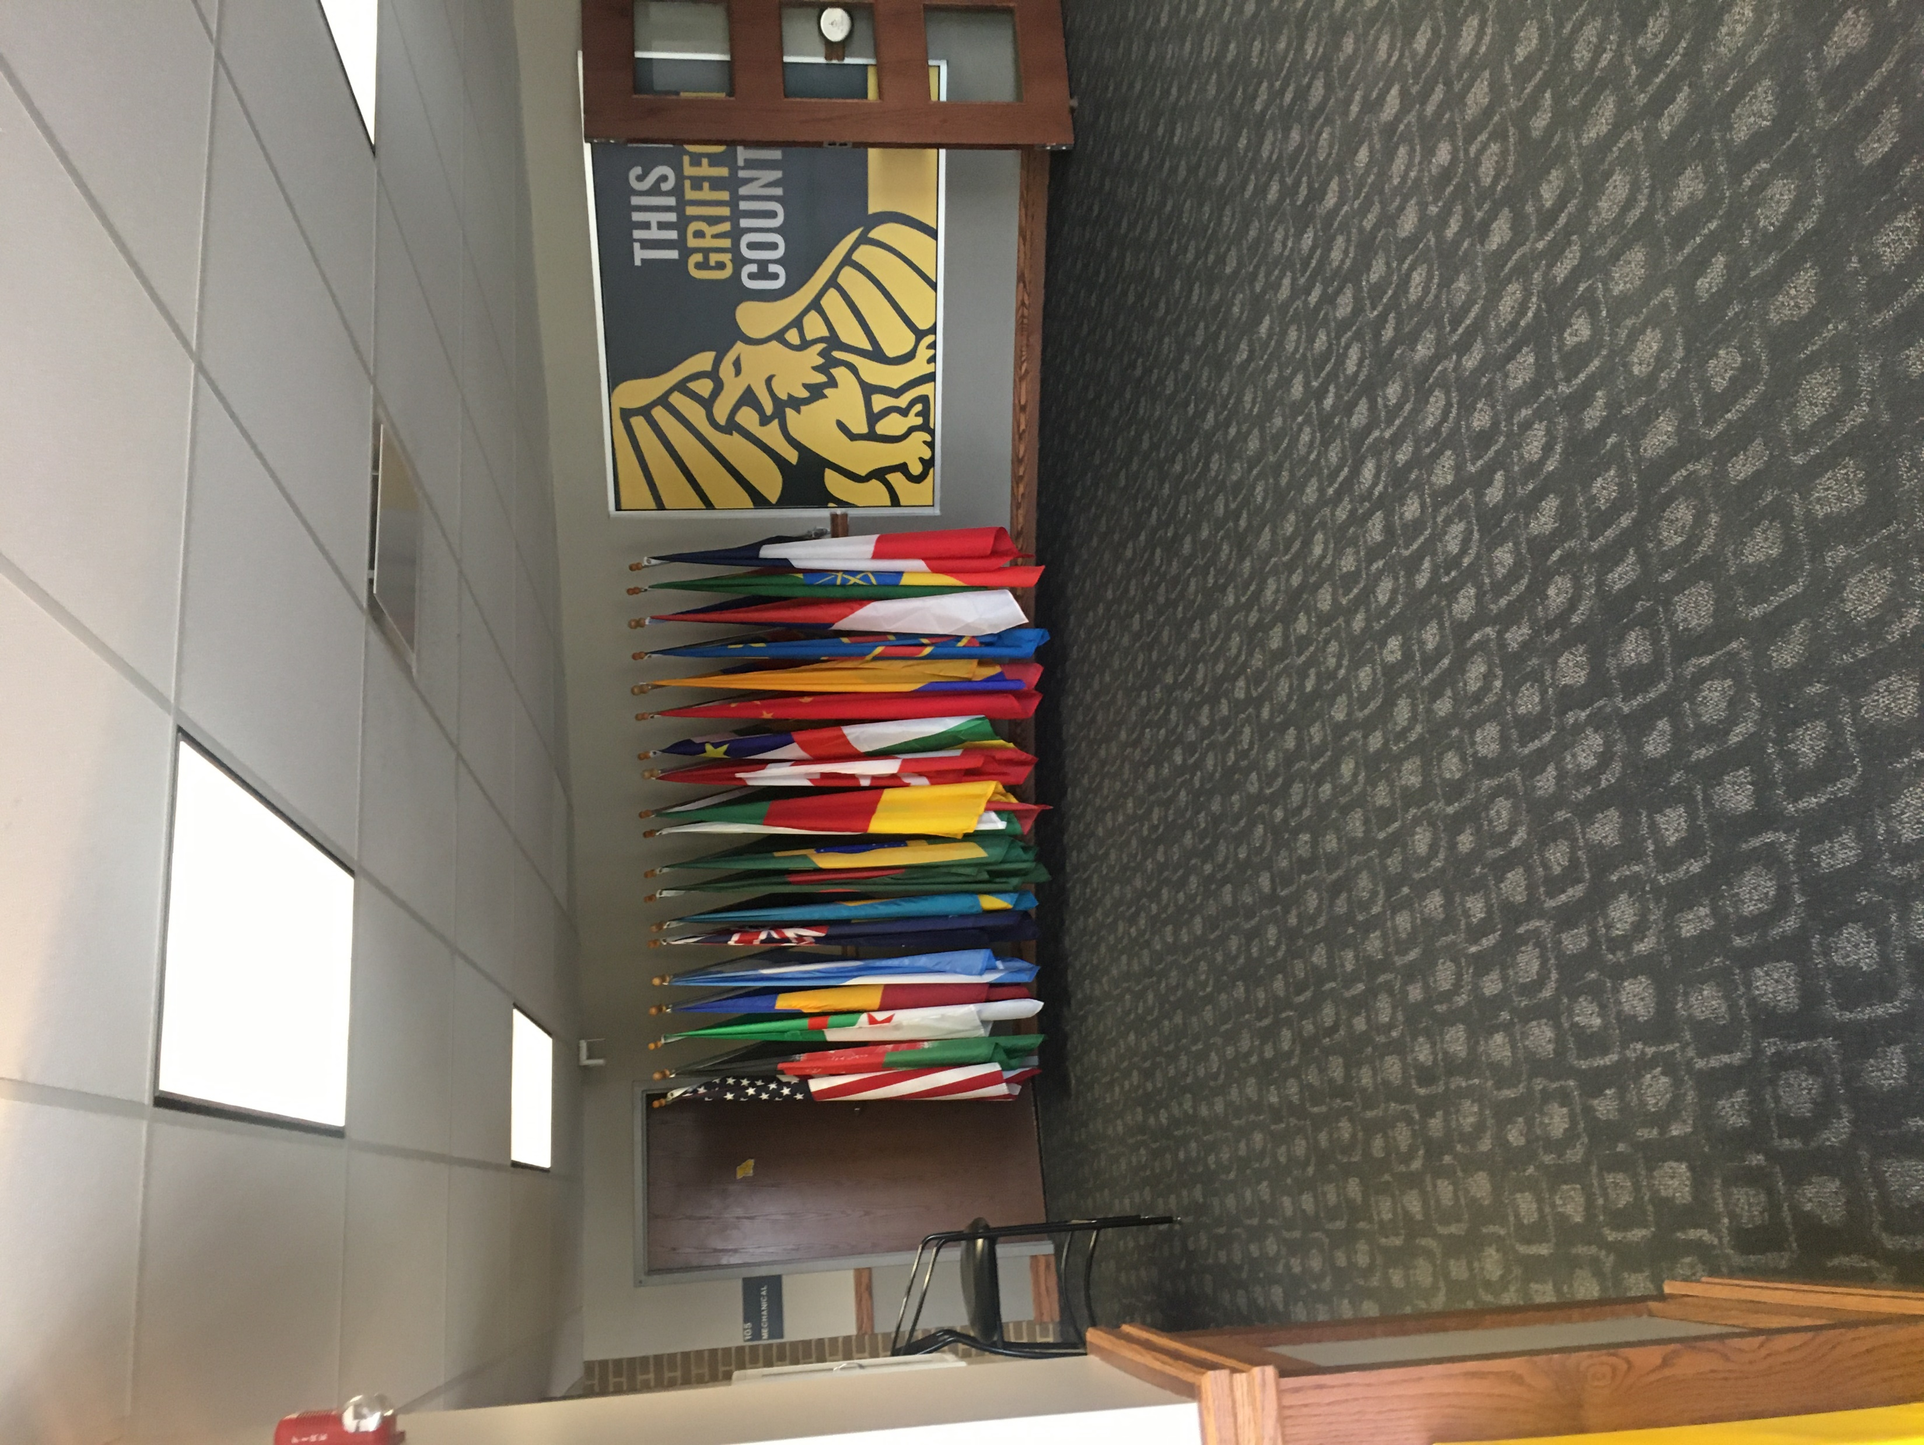
Wall # 4 Left of Front Doors
Width 240 Inches
Height 89.5 Inches
Alternate #2 Graphics to cover door

Slide 5
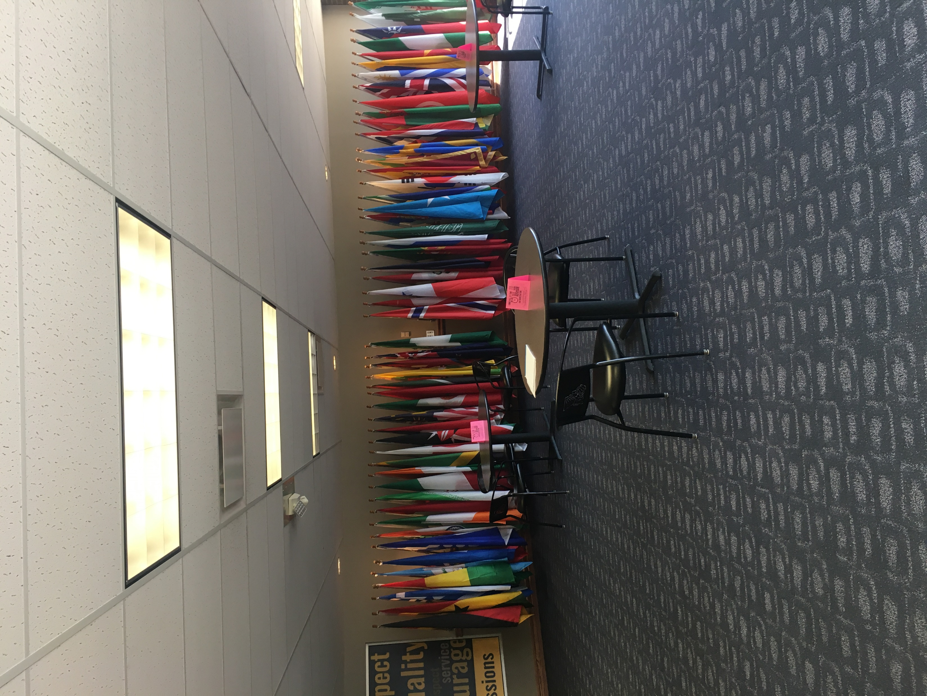
Wall #5 Right of Front Doors
Width 480 Inches
Height 89.5 Inches
Flags will be removed and chair rail removed prior to install.

Slide 6
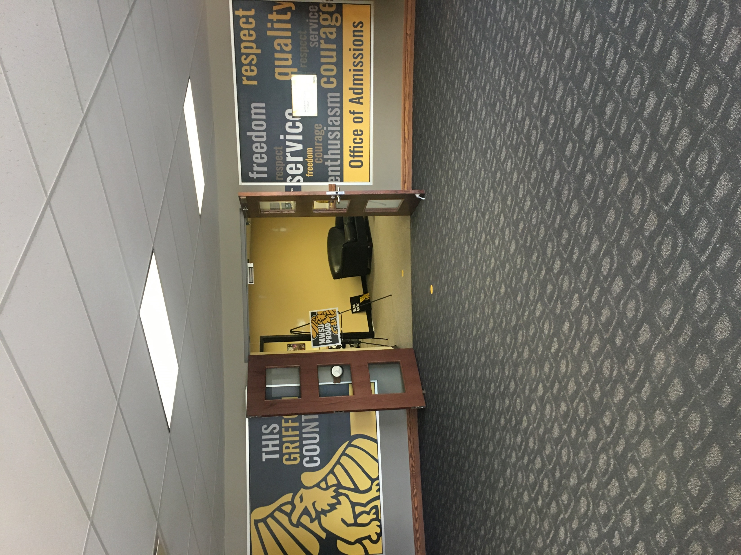
Wall #6 Over Top of Front Doors
Wall #7 Two Glass Windows
Width 75 Inches
Depth 10 Inches
Width 82 Inches
Depth 63 Inches
These entry doors will not be covered with vinyl.
Removal of existing vinyl will need to be included in bid.

Slide 7
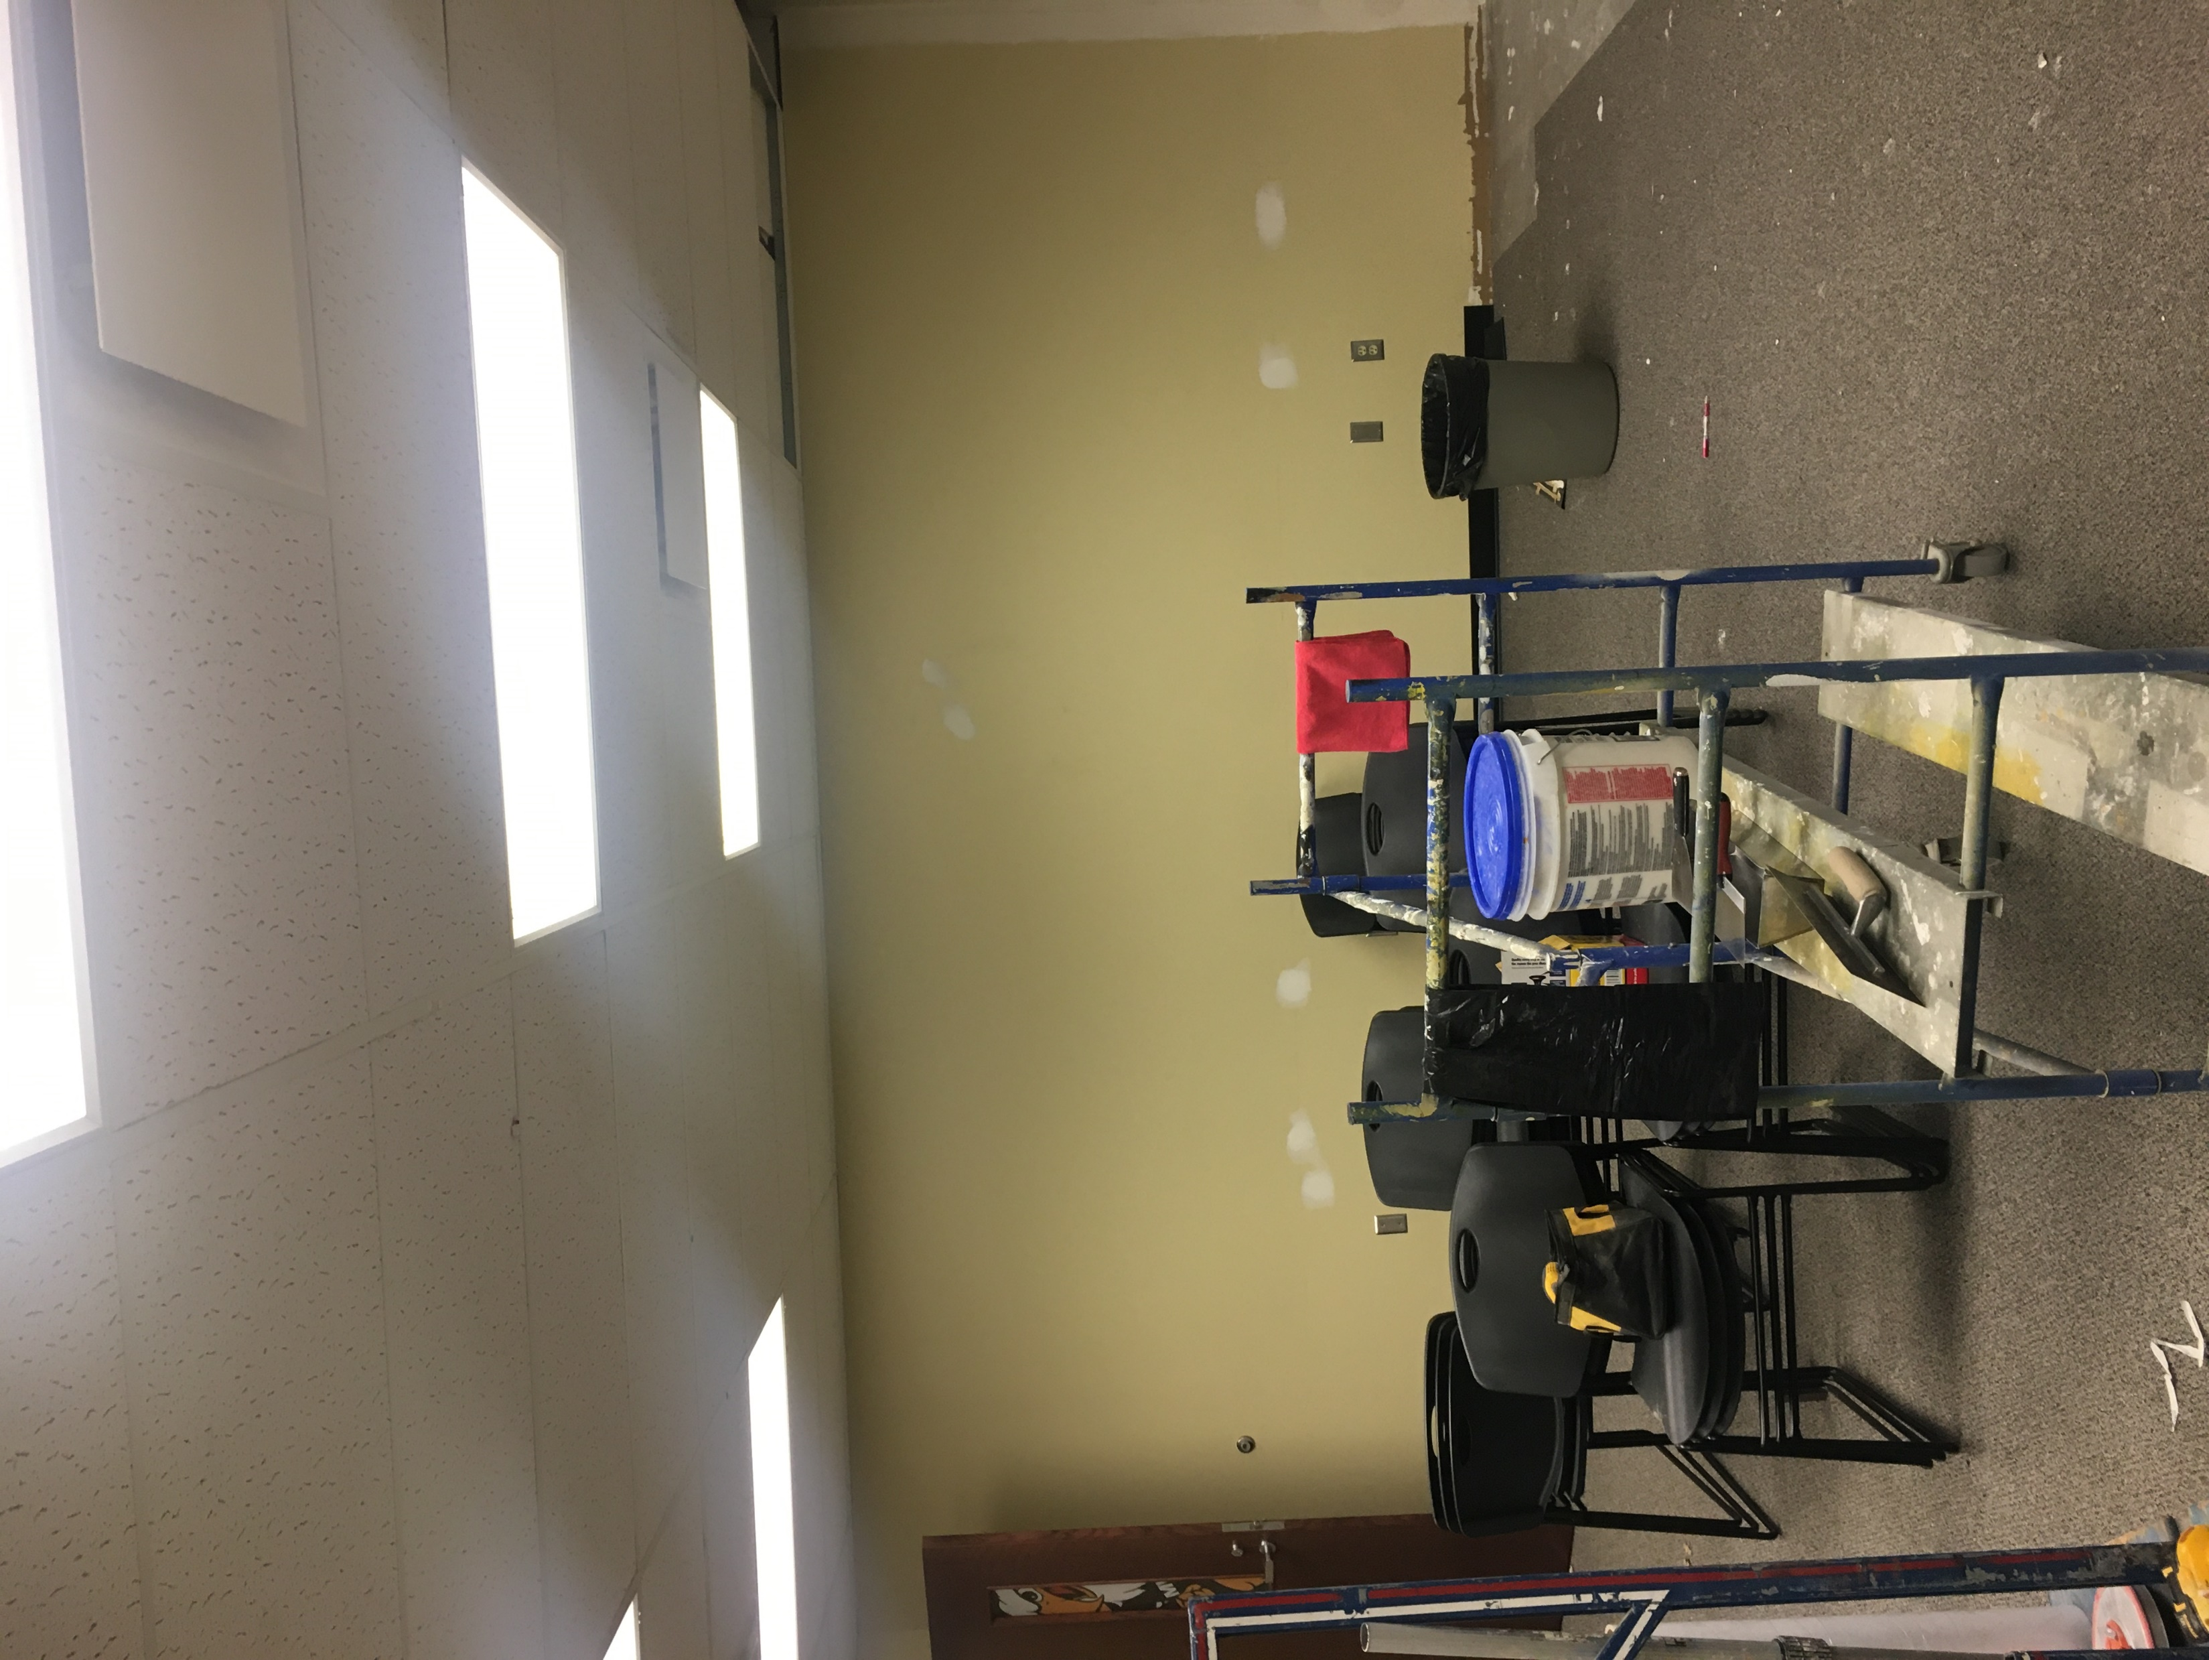
Alternate Wall #1 East Back Wall Tour Room
Width 227 Inches
Height 91.5 Inches

