Slide 1


Oplign Activation Information Information in this packet includes:
How to gain access to company portal
URL, QR codes, social media links
Header & Footer examples
Recommended link placement for optimization and lessons learned
Hyperlink html code example for reference

Slide 2
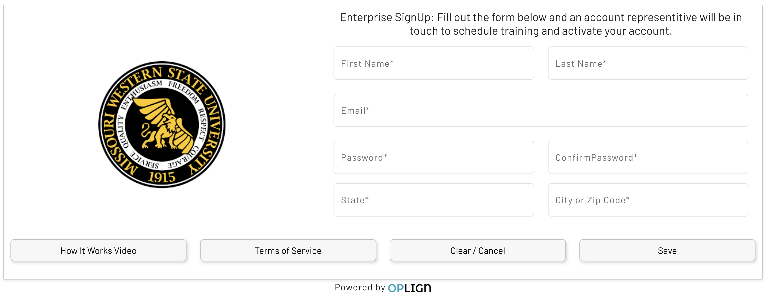
Gaining Portal Access
Click on the below link
(b) Complete and ‘Save’,
(c) Confirm your account via email from Oplign,
(d) Email jeff@oplign.com or alex@oplign.com when you’ve confirmed your account,
(e) We’ll connect your email to the Gartner Oplign Portal and then let you know when your access is live
Directions for Career Center representatives to gain access to company portal
https://app.oplign.com/Account/FeaturedJobKioskSignUp?SelectedCompany=16421&Mode=f06d61c8-3f1e-4131-b463-7e8bcc4cde06

Slide 3
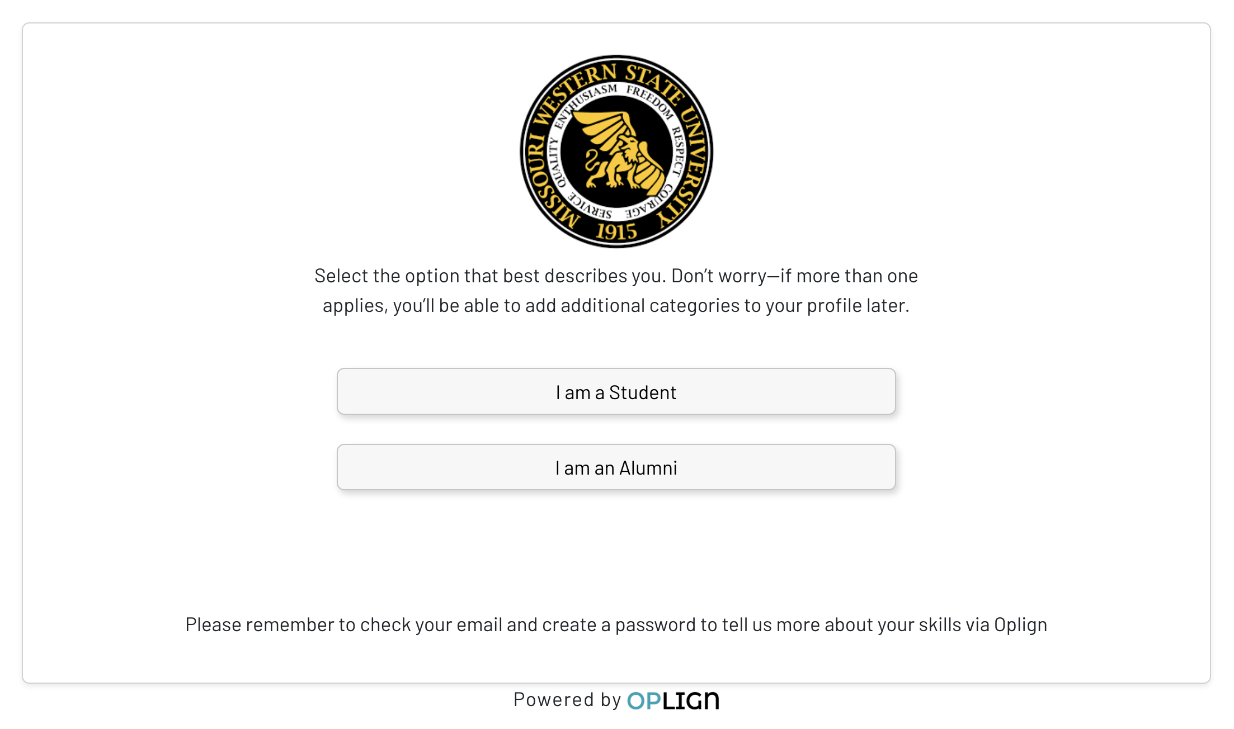
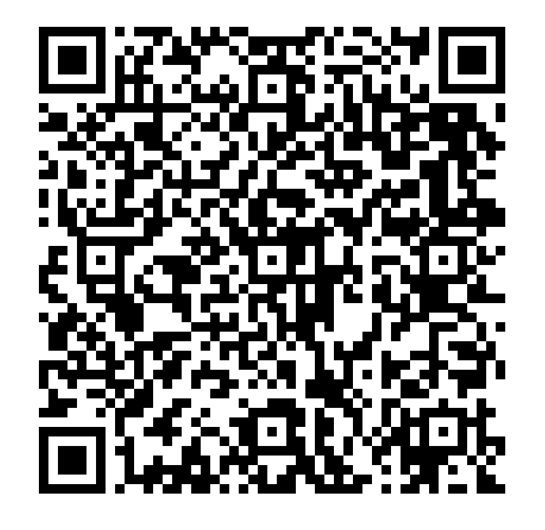
Links for Career Pages
https://app.oplign.com/Account/FeaturedJobKioskPrep?SelectedCompany=16421&Mode=f06d61c8-3f1e-4131-b463-7e8bcc4cde06&Ref=edu

Slide 4
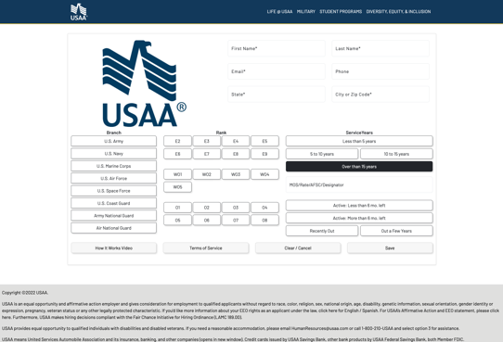
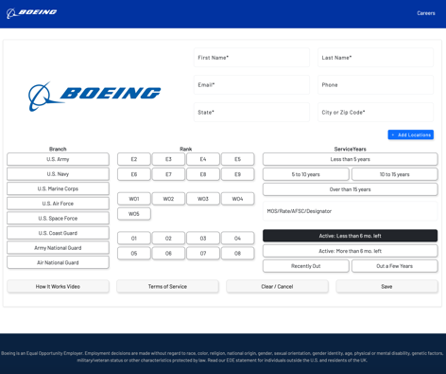
Kiosk – Optional Header & Footer Examples
Header and Footers can be tailored with your preference and disclosure language.
Here are two current examples:

Slide 5
Career Page –
Link Placement Recommendation
Lessons Learned to Optimize Functionality:
The closer the buttons are to the main URL the more people will click through. If you bury the buttons on some page three levels down, you will not have many people clicking through. Remember the goal is conversion, and busy, in-demand job seekers won’t jump through a bunch of hoops to get to the careers page.
“Above the fold” positioning is best, make sure the buttons are seen as soon as the page loads.
Have some explanatory text, but don’t be too specific. Leaving a little ambiguity about what the actions for the user should be will generate higher click-through rate and conversion, believe it or not.
Don’t add additional “scary warning text” beyond what the compliance people require (if anything). Conversion will be higher the smoother the process is.

Slide 6
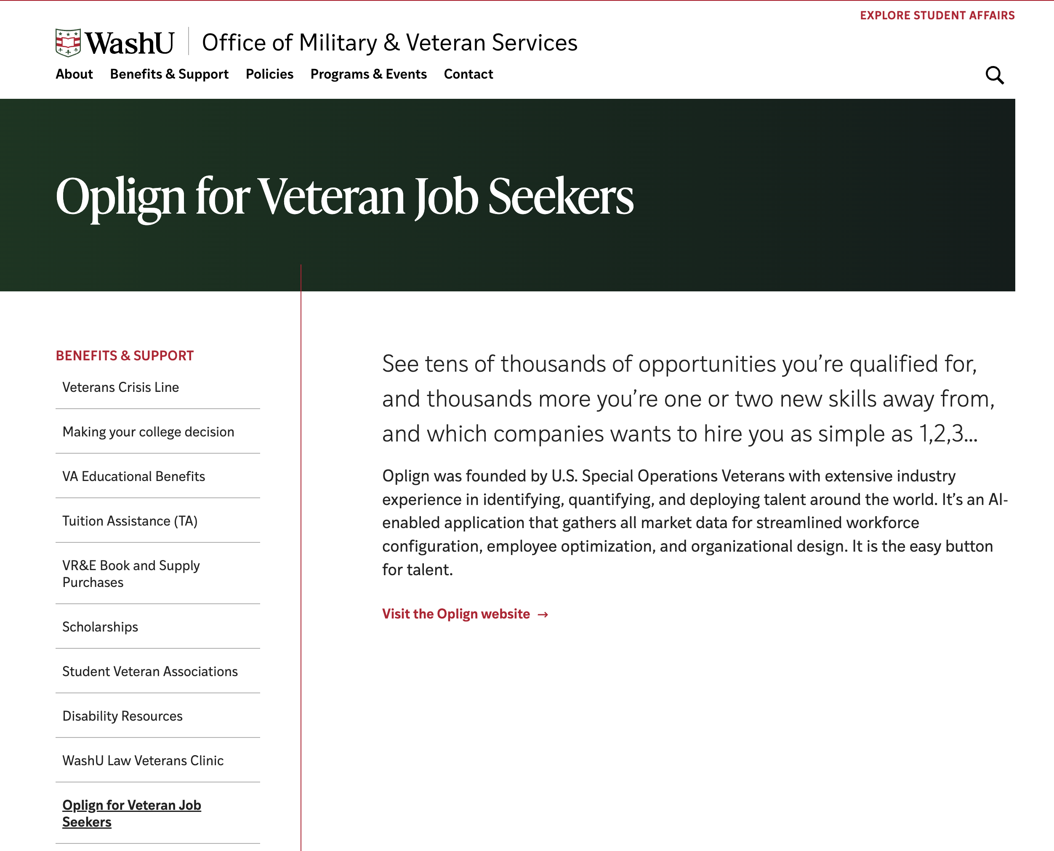
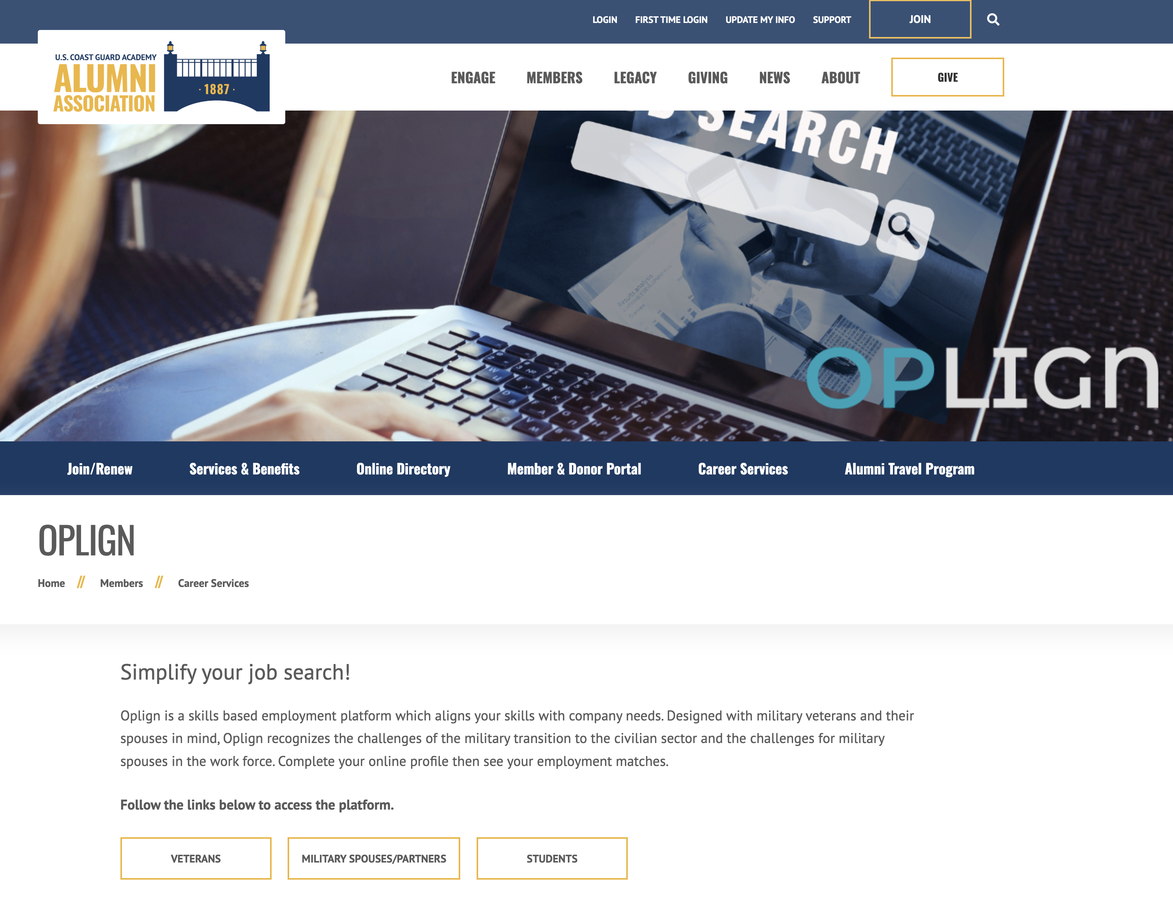
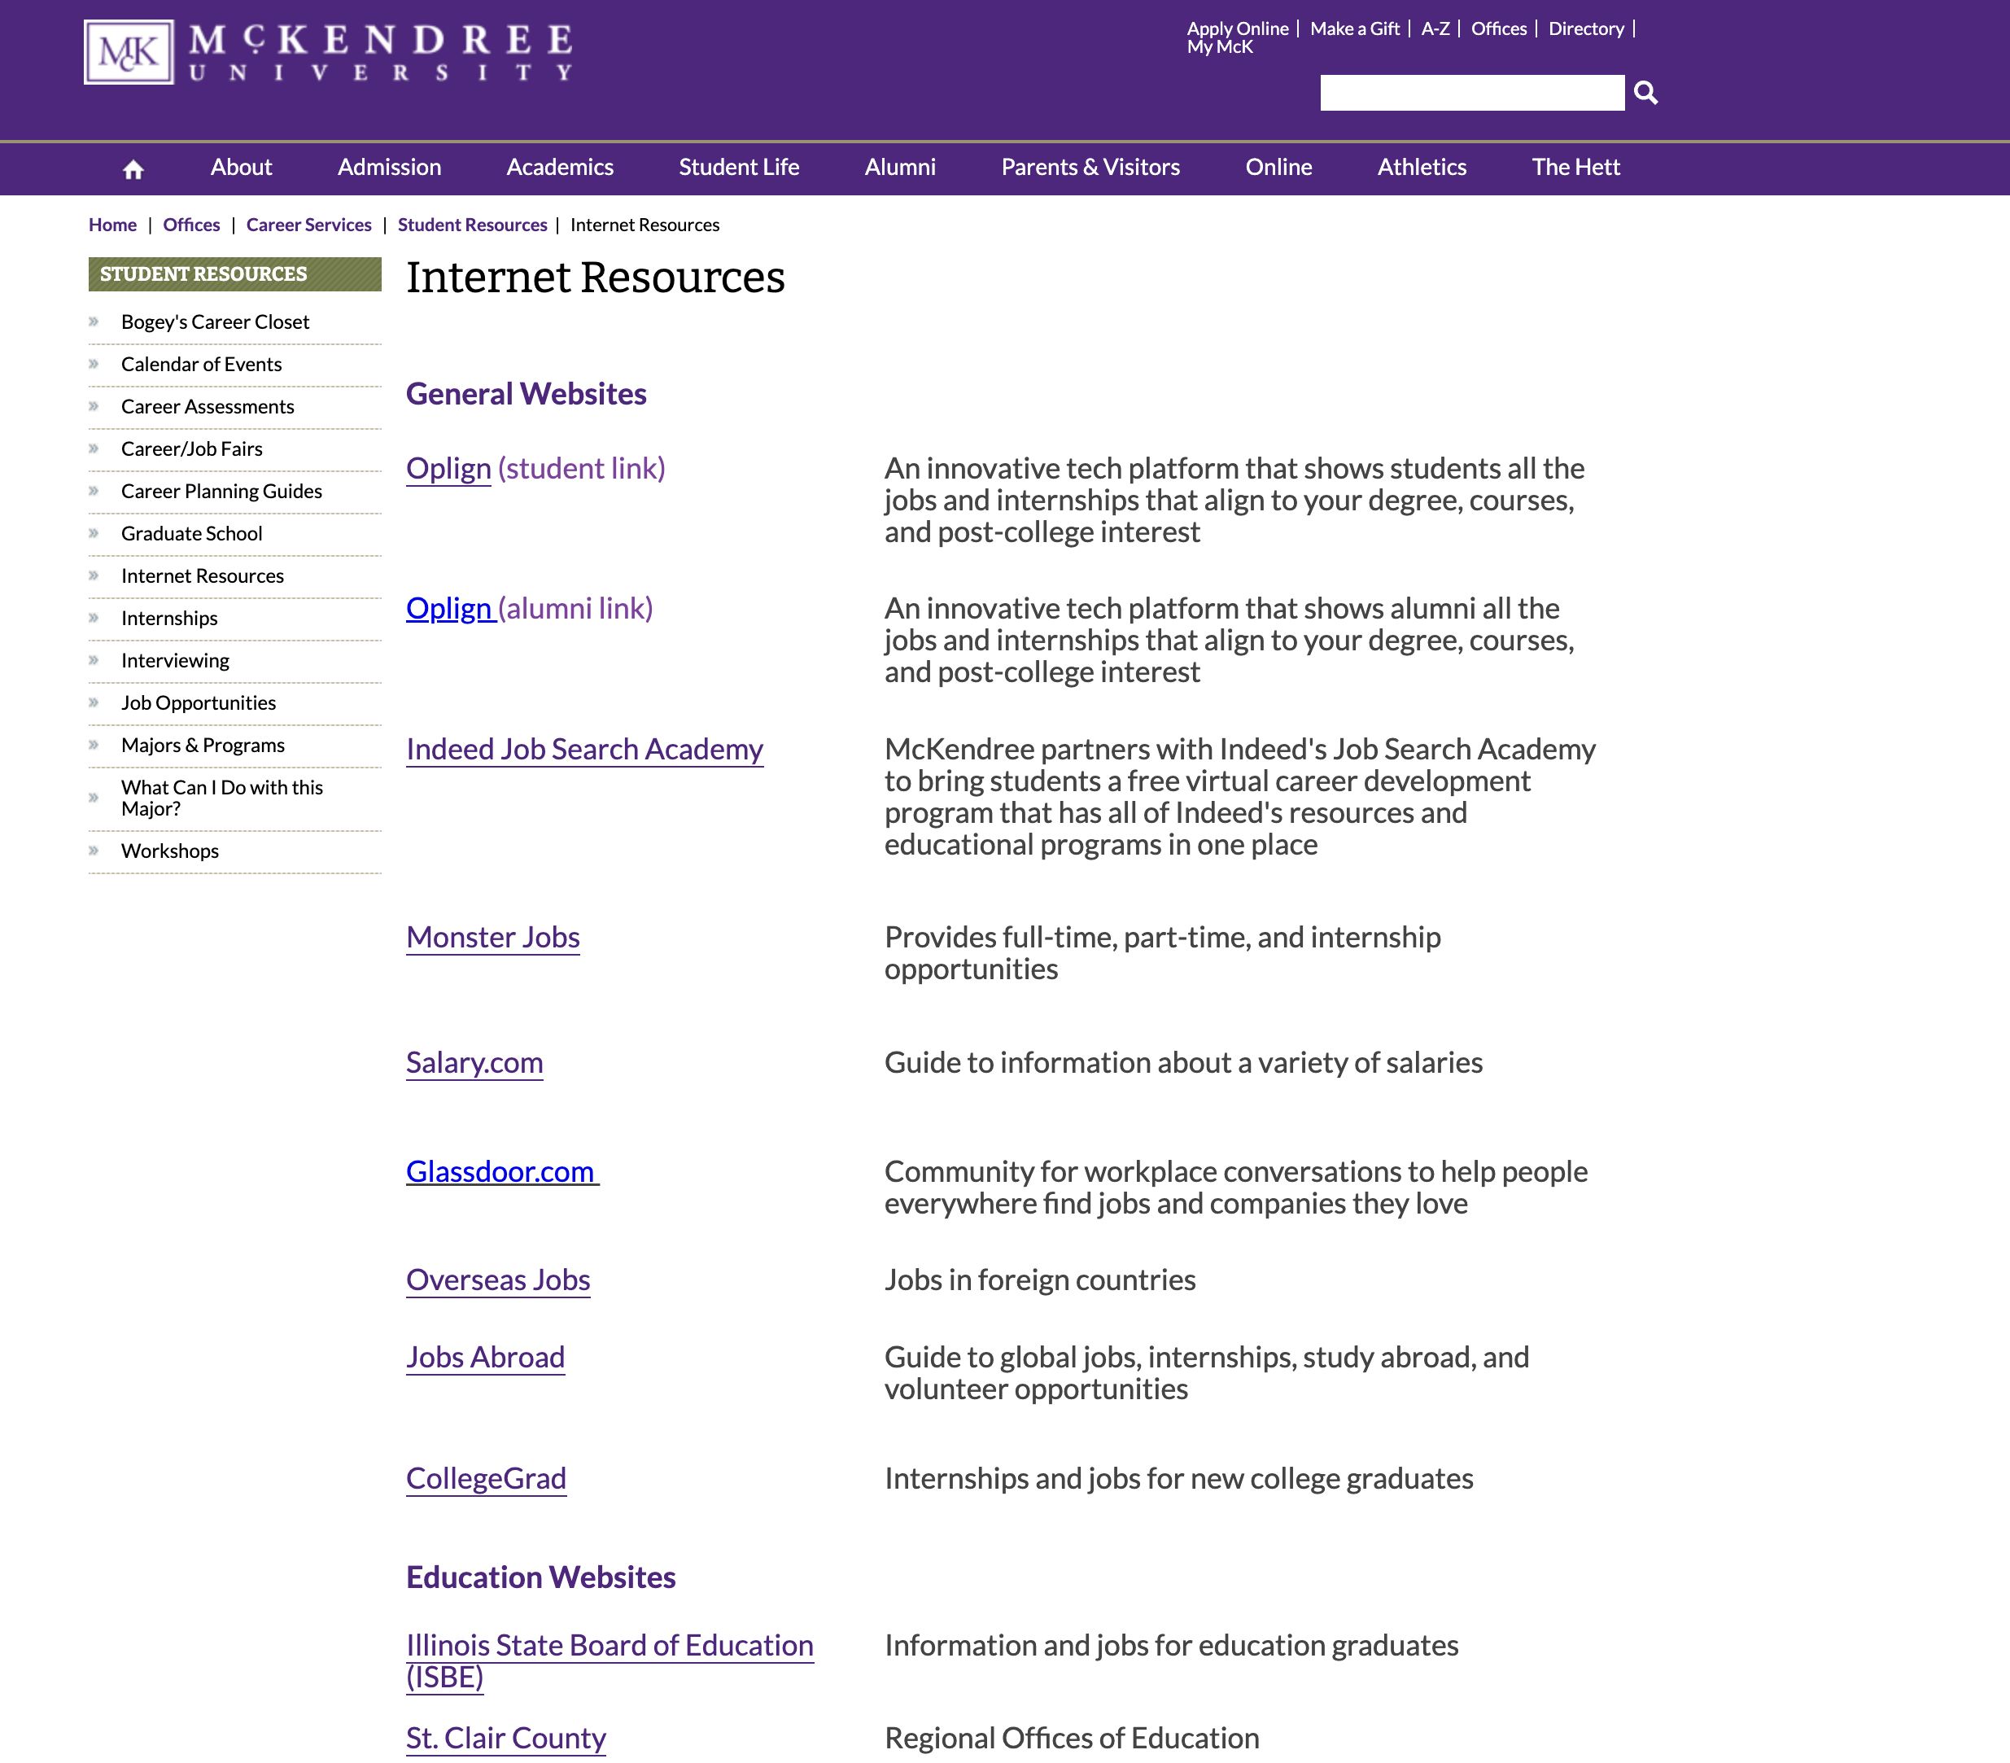
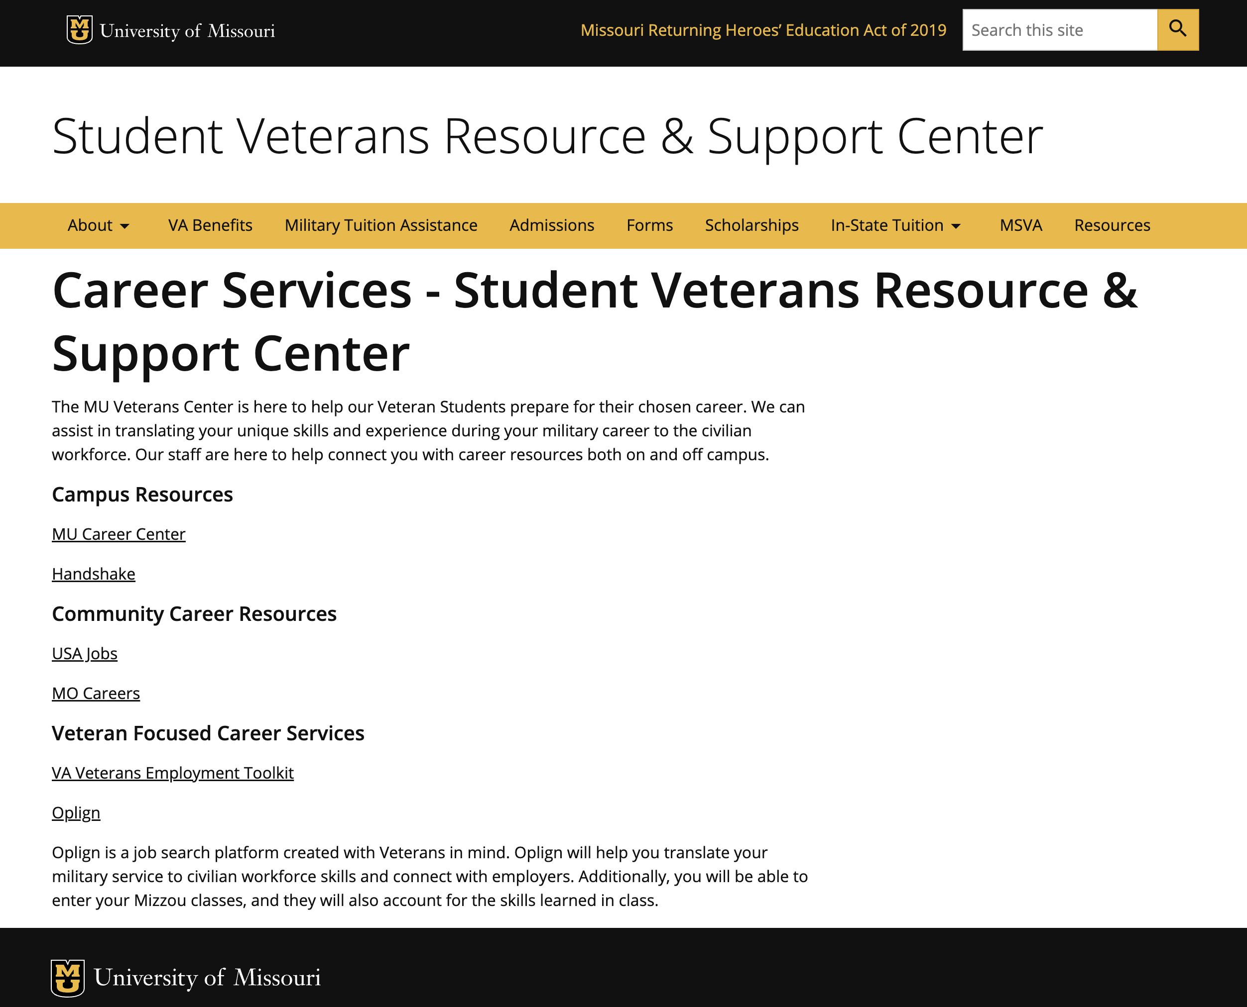
Career Page – Examples
Oplign hyperlinks placement examples:
Links to Examples. . .
WashU - https://veterans.washu.edu/benefits-and-support/oplign-for-veteran-job-seekers/
Mizzou - https://veterans.missouri.edu/resources/career-services/
Coast Guard Academy Alumni Association - https://www.cgaalumni.org/s/1043/21/interior.aspx?sid=1043&gid=1&pgid=7339
McKendree University - https://www.mckendree.edu/offices/career-services/student-resources/job-search-internet-resources.php

Slide 7
Hyperlinks for Webpage
Instructions:
Simply ‘href’ each button or image element to the relevant link above.
For example, on USAA’s page the Veteran button HTML looks like this:
<a class="btn-yellow mar-bottom-sm" href=" https://app.oplign.com/Account/FeaturedJobKiosk?SelectedCompany=1033&amp;Mode=a50831dc-3d13-4817-a29e-723e7fdb77e6" data-custom-event="true" data-custom-category="Content Page element" data-custom-label="Veterans button">Veterans Job Search</a>
See How Other Companies are employing links:
https://www.careers.jnj.com/military
https://jobs.navyfederal.org/hcmUI/CandidateExperience/en/sites/nfcu/pages/military-hiring
https://jobs.boeing.com/veterans
https://careers.zoom.us/veterans
https://www.usaajobs.com/military
https://lanl.jobs/creative/veterans
https://www.verizon.com/about/careers/military
Questions? Email Alex: alex@oplign.com

