Slide 1
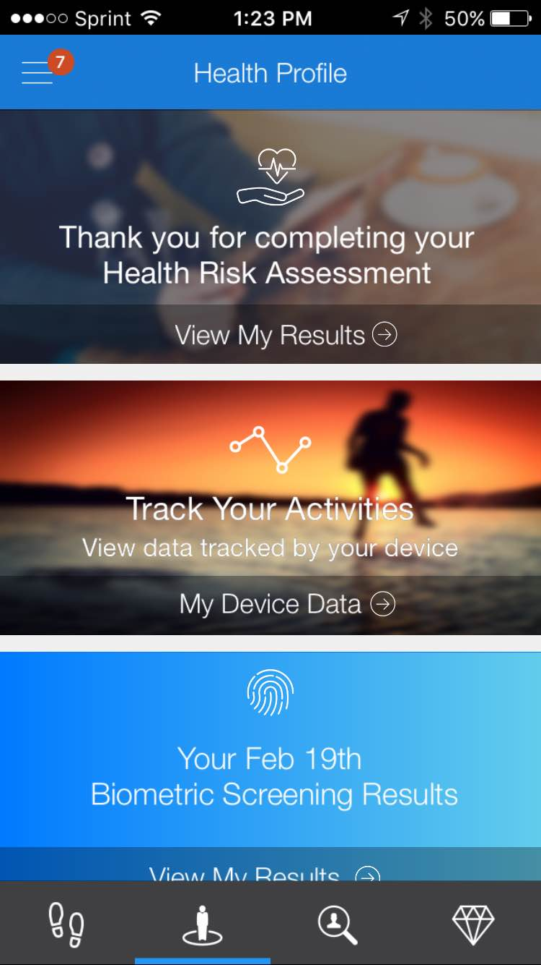

A Healthier You

Slide 2

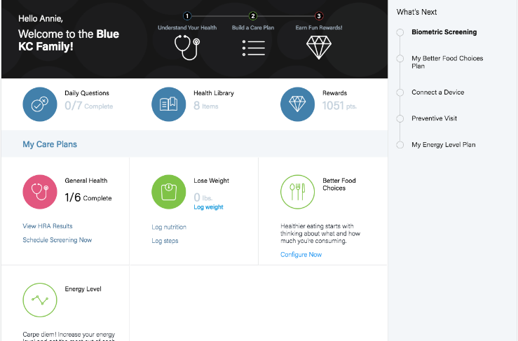

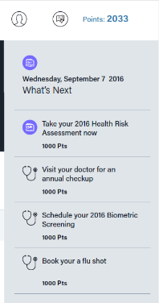
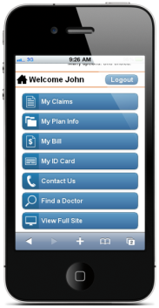
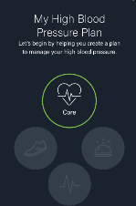
A Healthier You
Innovative tools:
Tailored/personalized member portal experience
Integration of claims data
Personalized communications and Care Plans
Fitness device integration
Mobile access
Rewards

Slide 3
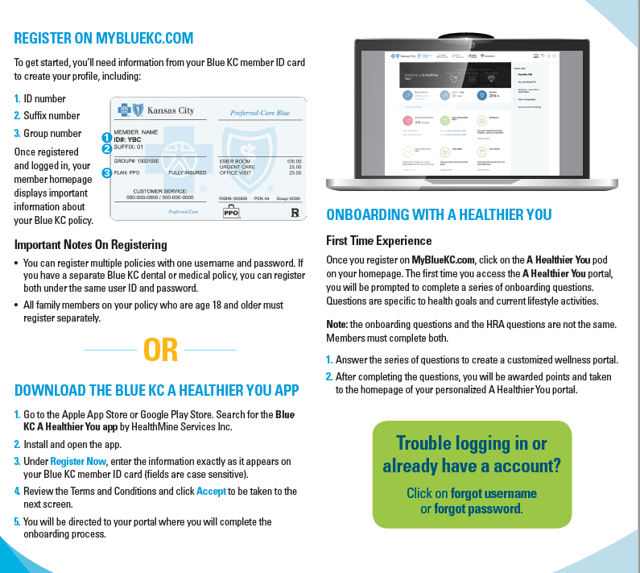
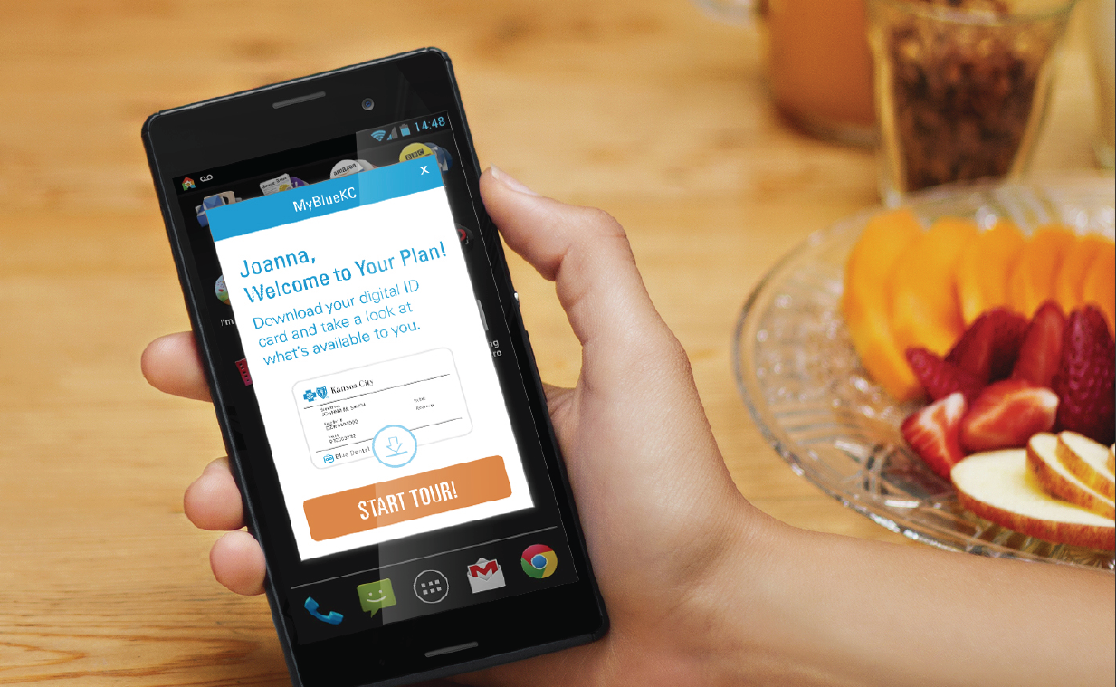
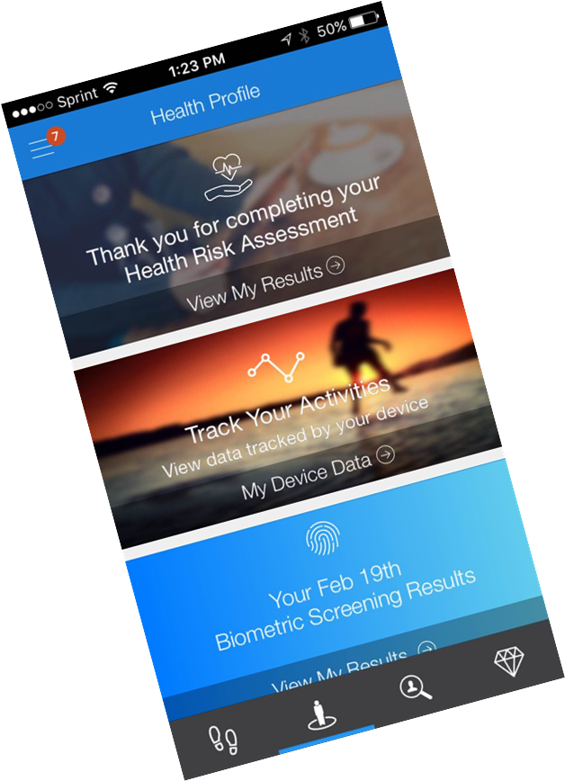
How to Access A Healthier You
Notes:
Online: If a member already has a username/password they will not have to change that
All members will have to register on the App

Slide 4
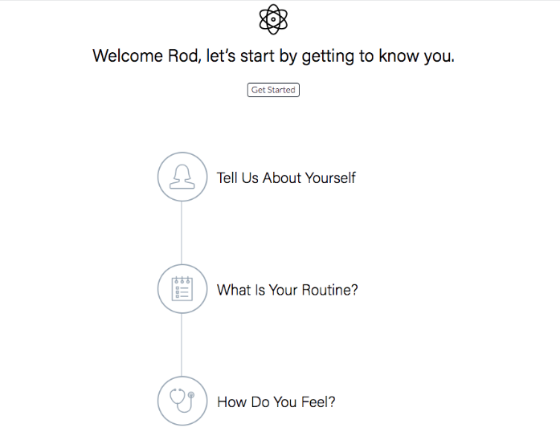
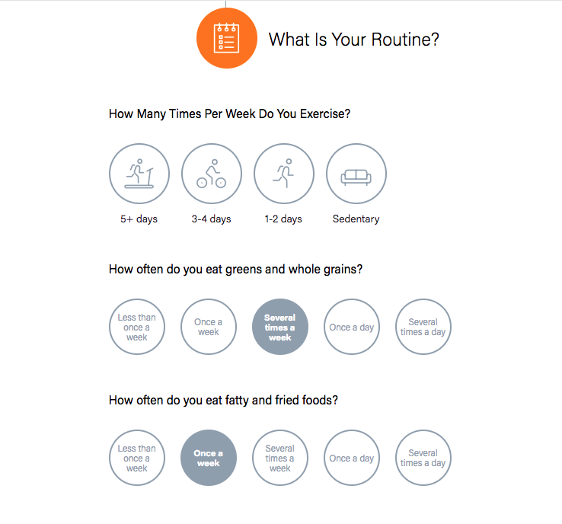
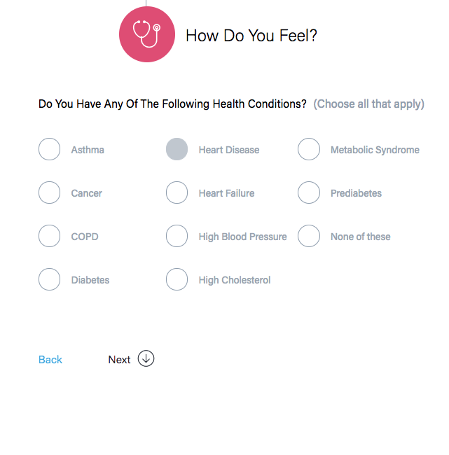
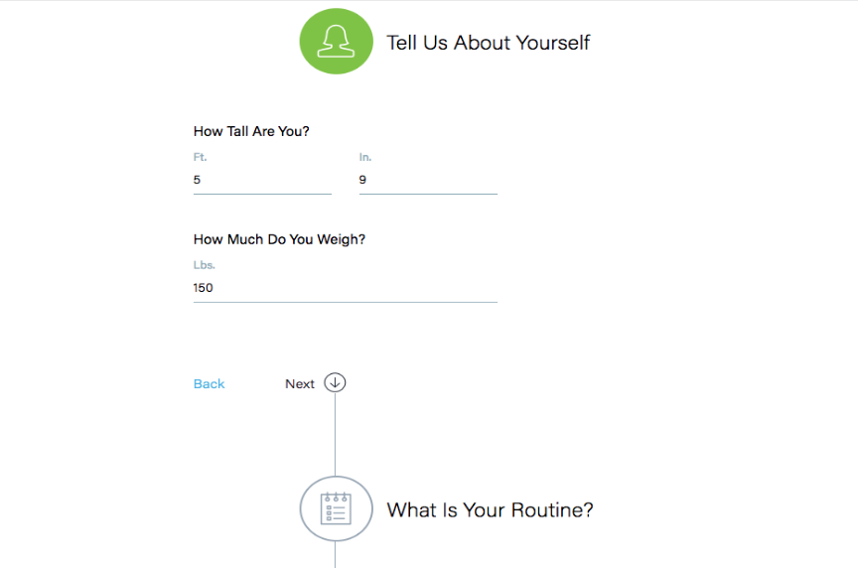
A Healthier You Registration
First Time Experience – Onboarding Questions
1
2
Members answer questions upon first log in to create a customized wellness portal.
Questions are specific to health goals and current lifestyle activities. They are not based on the Health Risk Assessment.
3
Members are awarded points and are taken to the home screen of their personalized A Healthier You portal.

Slide 5
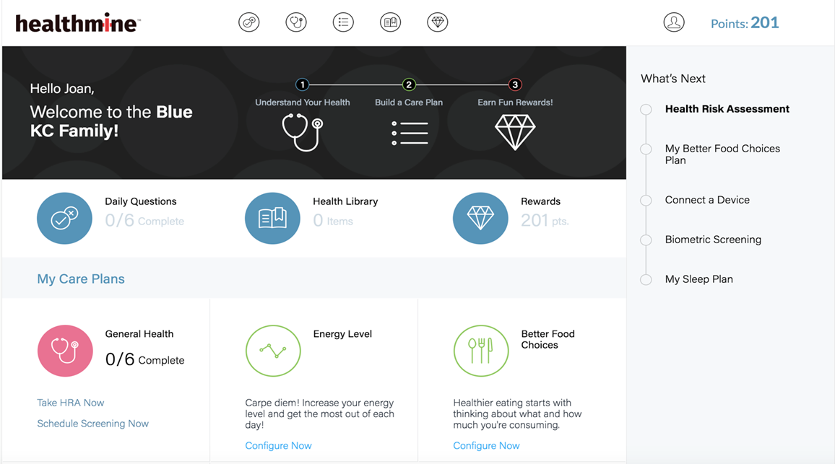
New A Healthier You Member Portal
Health Risk Assessment
Member’s Personalized Care Plans

Slide 6

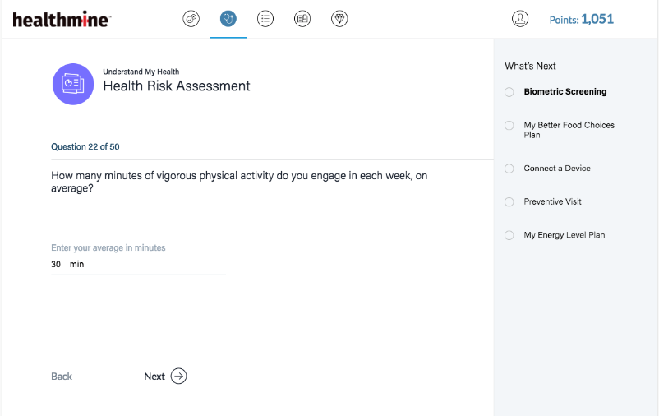
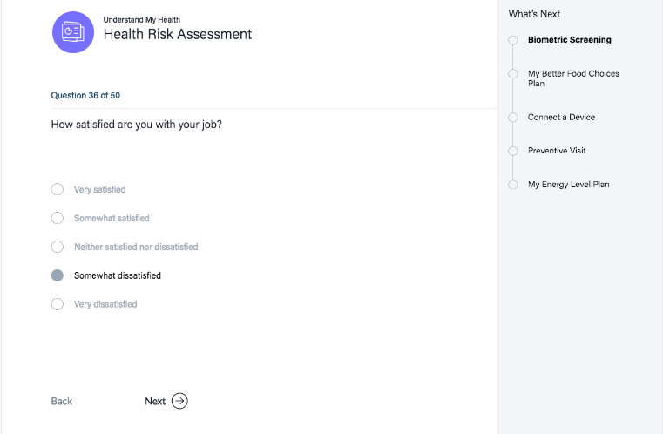
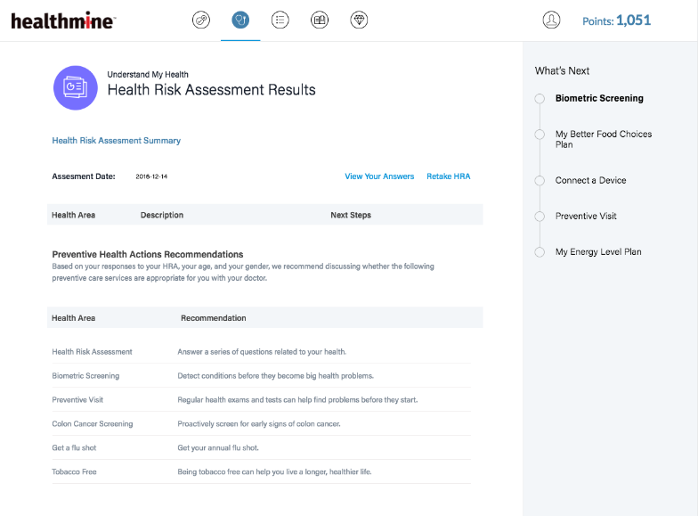
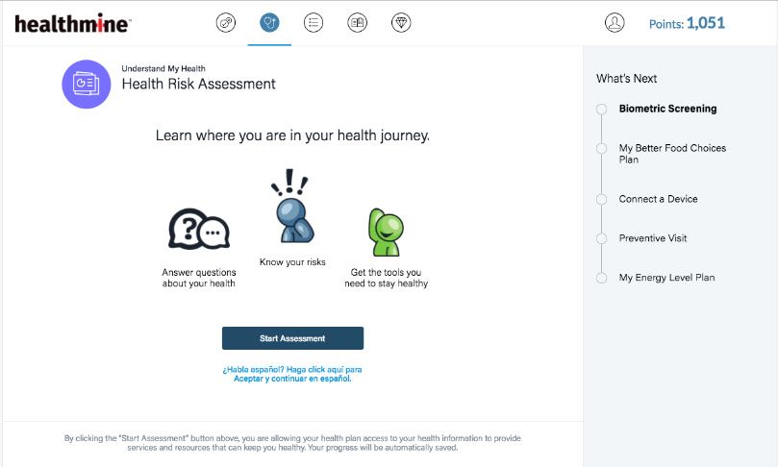
Health Risk Assessment
Provides a snapshot of current health status, simplified process and provides more member website personalization.
Take your health risk assessment
Register for an event or download a form to take to your physician

Slide 7
Personalized Wellness Engagement Activities Tailored Care Plans
Preventive Care Plans
Cancer Screening
Age & Gender Based
Cervical
Breast
Colorectal
Flu Shot
Lifestyle Care Plans
Understand My Health
Learn About Health Risks
Be Happier
Be More Physically Active
Be More Relaxed
Improve Energy
Lose Weight
Make Better Food Choices
Sleep Better
Asthma
Behavioral Health
COPD
Diabetes
Heart Disease
Heart Failure
Hyperlipidemia
Hypertension
Metabolic Syndrome
Obesity
Pregnancy
Smoking
Chronic Condition Care Plans

Slide 8

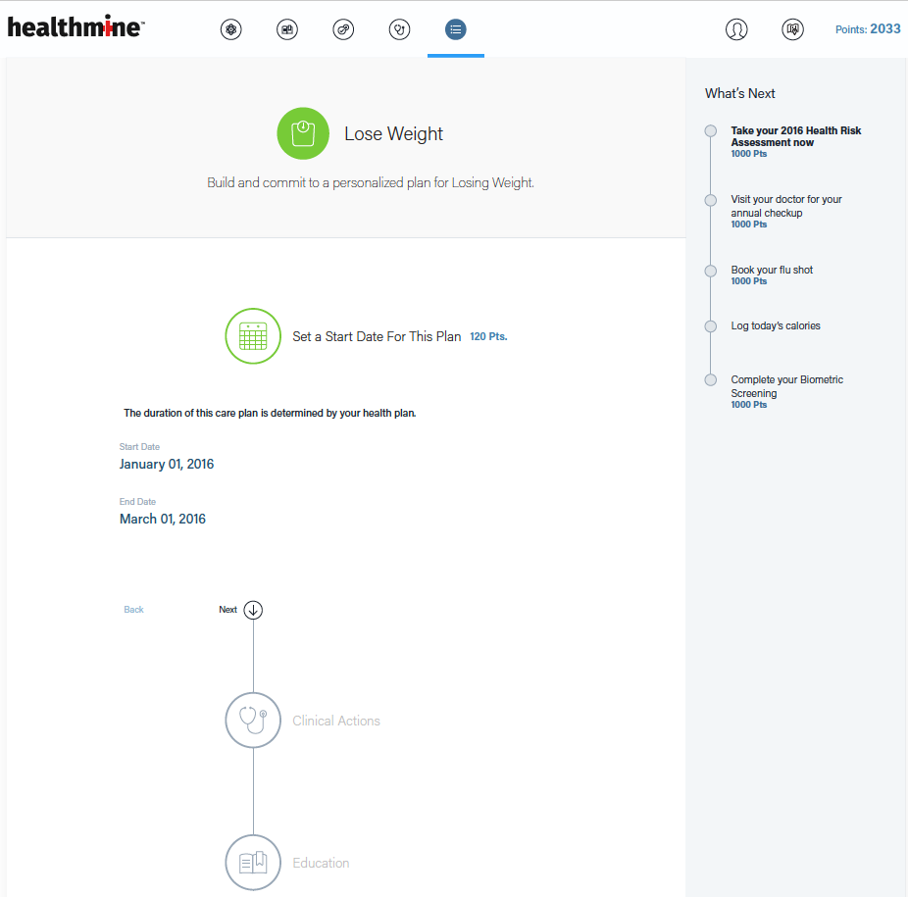

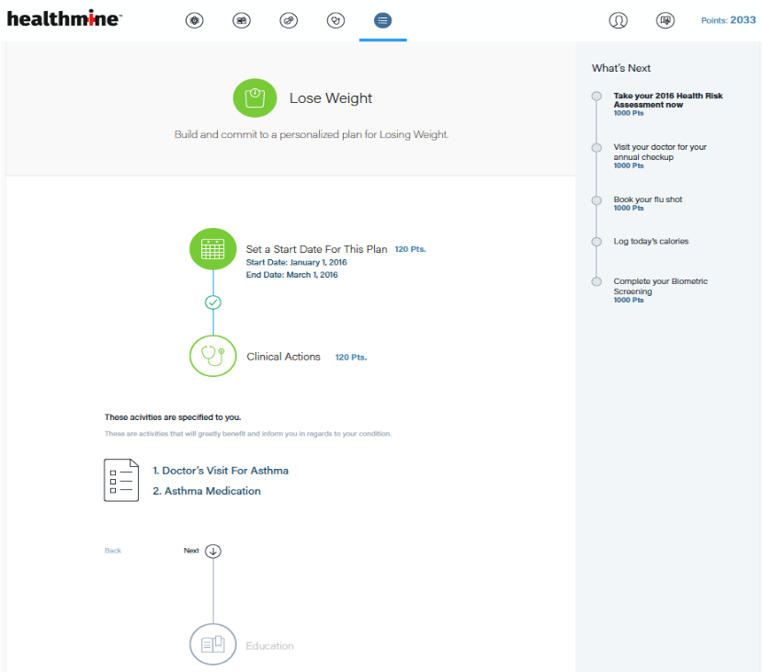
Care Plans

Slide 9
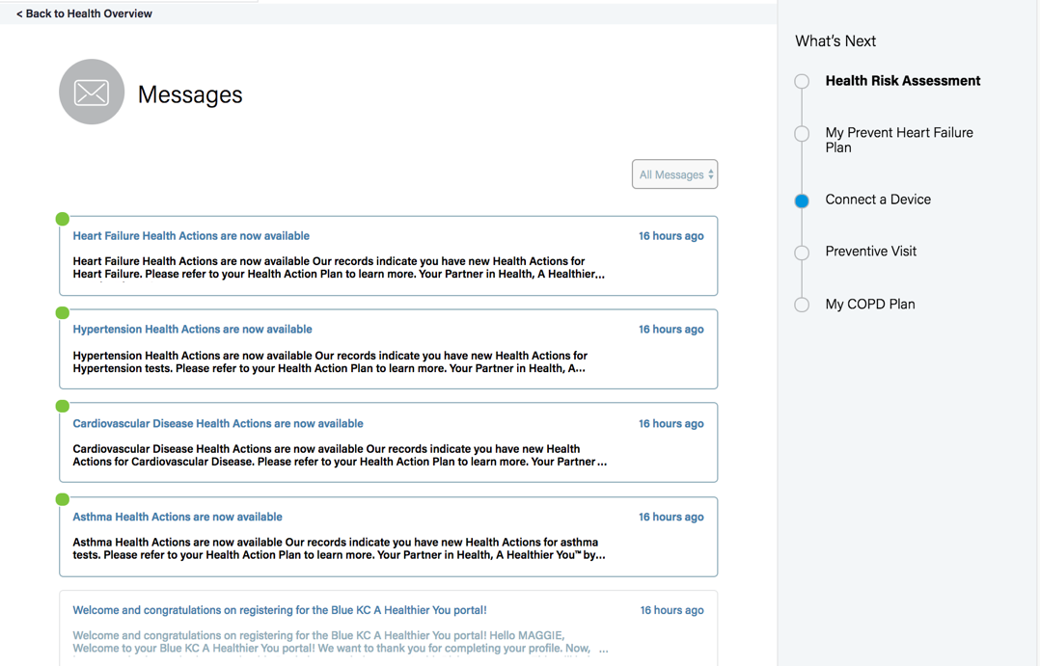
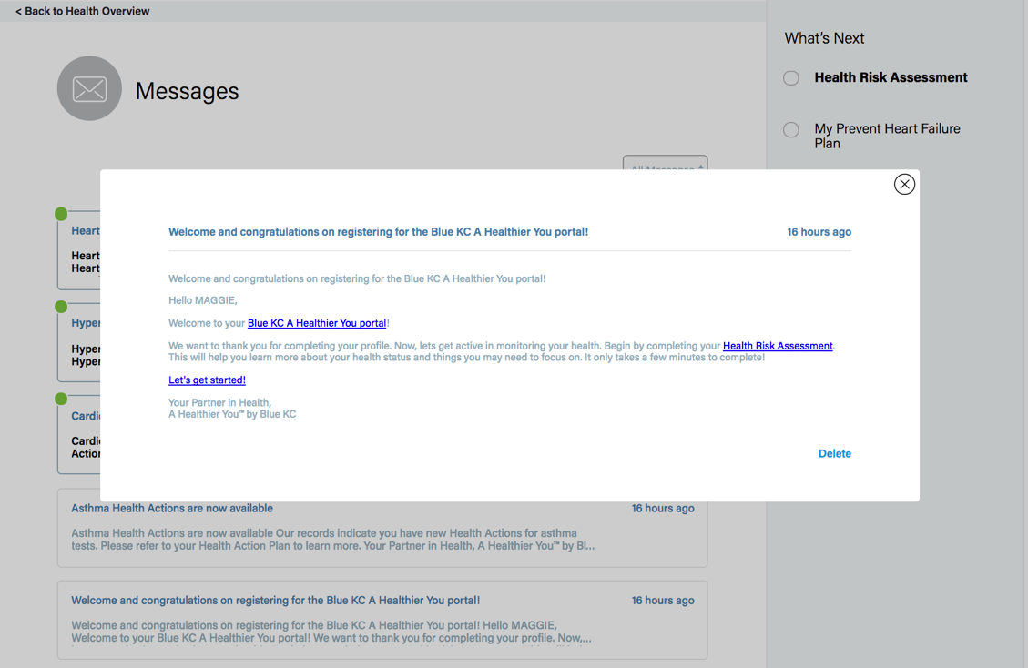
Message Center
Message notifications are sent to the member’s preferred email address.

Slide 10
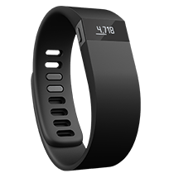
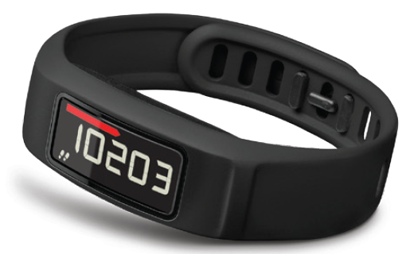
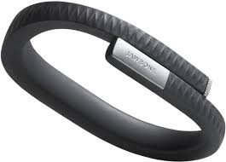
Device Integration – Activity Trackers and Smart Weight Scales
Currently Integrated with:
Garmin
FitBit
BodyMedia
Jawbone
RunKeeper
Strava
MyFitnessPal
Mapmyfitness
Misfit
Moves
HatTrick Motion
Through the A Healthier you program, clients have two options to take advantage of manufacturer discounted pricing on a variety of devices.
Garmin is offering Blue KC employer groups a discounted price of the new vívofit
Blue KC members have access to individual purchase discounts via the A Healthier You platform for Garmin and Withings brand devices.
Blue KC will continue to update our portal to include additional devices as they enter the marketplace.

Slide 11
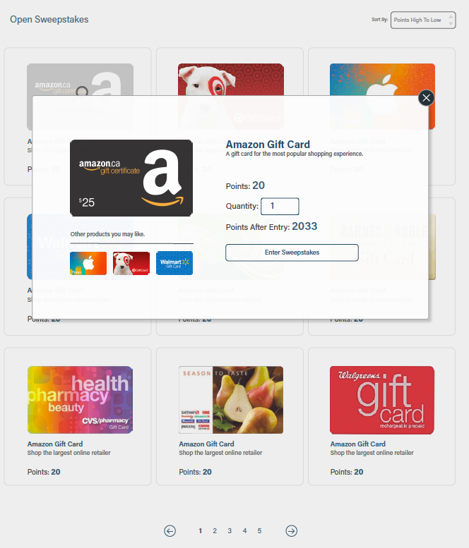
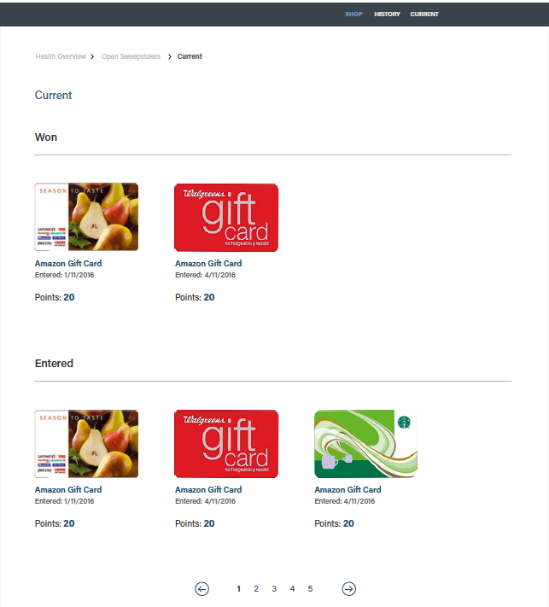
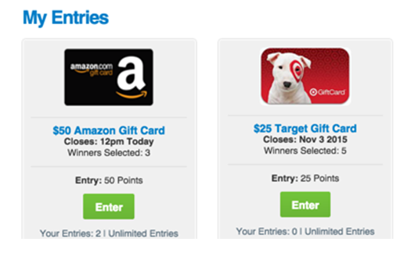
Sweepstakes Rewards
Monthly sweepstakes offer a variety of prizes.
Members can use their points earned through the website to opt into sweepstakes drawings.
Based on current rulings, sweepstakes prize values that are awarded will contribute to the maximum allowable incentive for participatory and health contingent wellness programs. Blue KC recommends if you offer additional employer specific incentives, please review your design with your legal team to ensure compliance with current EEOC regulations.

