Slide 1
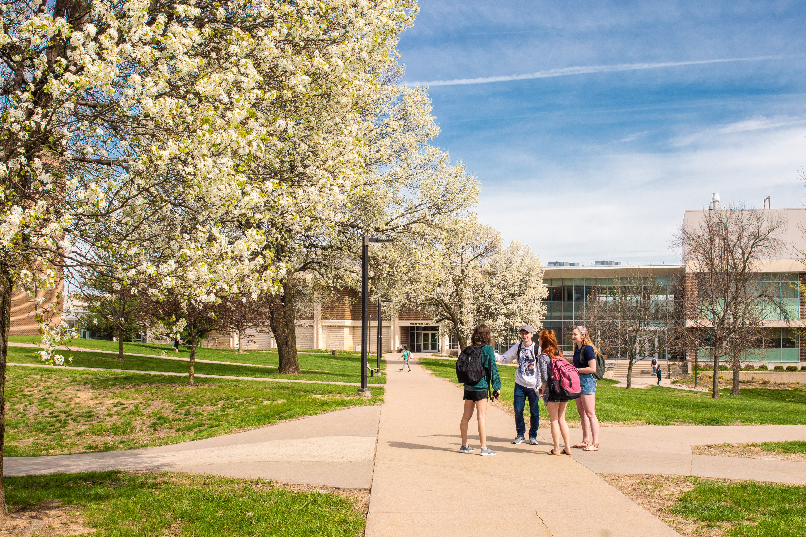
Honors Program Medal Ceremony
Spring 2023

Slide 2
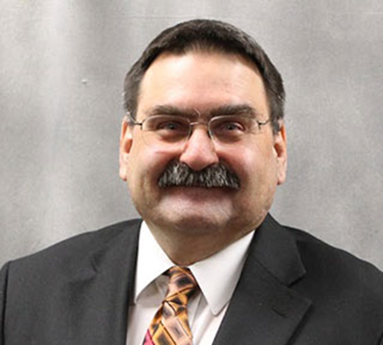
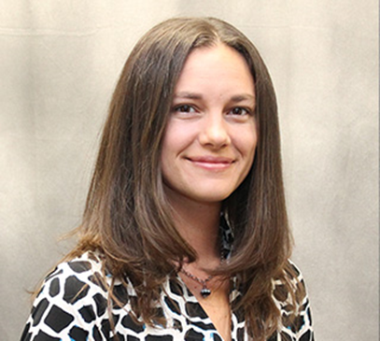
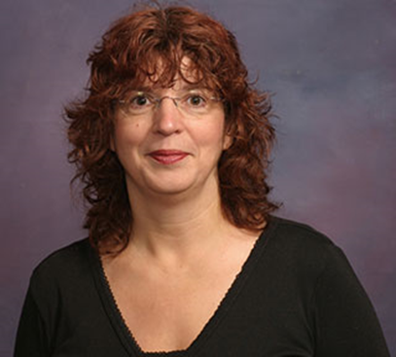
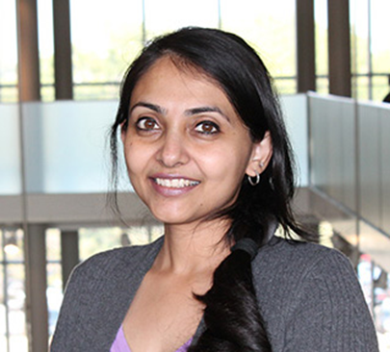
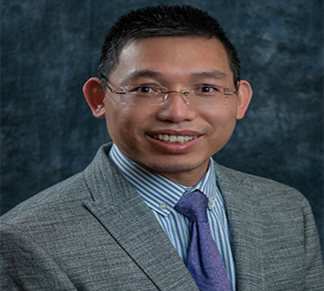
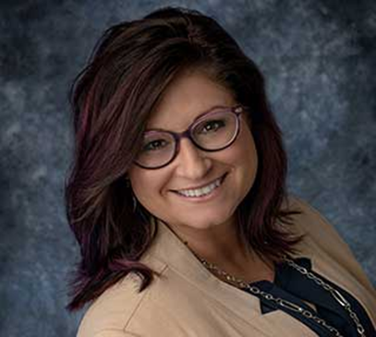
Honors Committee
James Mulder
Library
Dr. Angela Haas
History
Dr. Stacia Bensyl
English
Dr. Tilo Roy
Biology
Dr. Bin Qiu
Business
Dr. Becky Gregory
Nursing

Slide 3
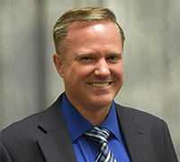
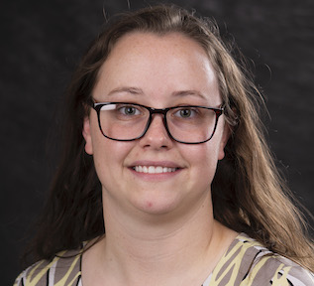
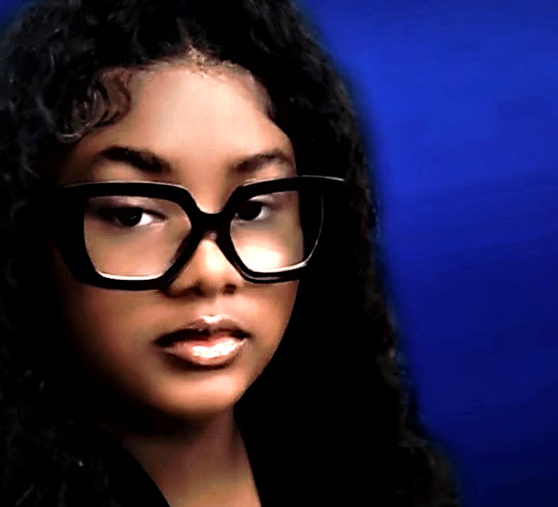
Honors Program Staff
Dr. Joel Hyer
Honors Director
Tiffany LeGrand
Administrative
Assistant
Zaya Webb
Student Employee

Slide 4
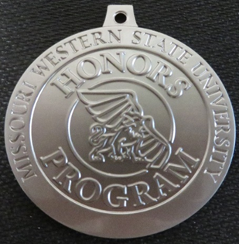
General Studies Honors

Slide 5
Devin Bensyl
Major: Management and Marketing

Slide 6
Bailey Daniels
Major: Nursing
Gold Griffon Scholarship recipient

Slide 7
Jennifer Dorris
Major: Psychology and Natural Science, and Chemistry
Minor: Biology
Plans After Graduation: Starting medical school at UMKC.
Most Memorable Moment: Going to London and Paris with my honors colloquium class.
Advice: Seek out different things that interest you and let the honors program help you pursue those interests.
Golden Griffon Scholarship recipient

Slide 8
Zoe Dunn
Major: Performing and Cinematic Arts

Slide 9
Devin Eckardt
Major: Performing and Cinematic Arts
Minor: Spanish

Slide 10
Erin Ellington
Major: Digital Animation
Minor: Chemistry
Plans After Graduation: Video production for education or technical rigging for animation.
Most Memorable Moment: For the final period of my first honors colloquia, everyone was invited to bring snacks and such as we all gave our presentations.
Advice: Use a program like google calendar, or a planner, to write down any due dates as soon as you get them, including any on the syllabus.
Golden Griffon Scholarship recipient

Slide 11
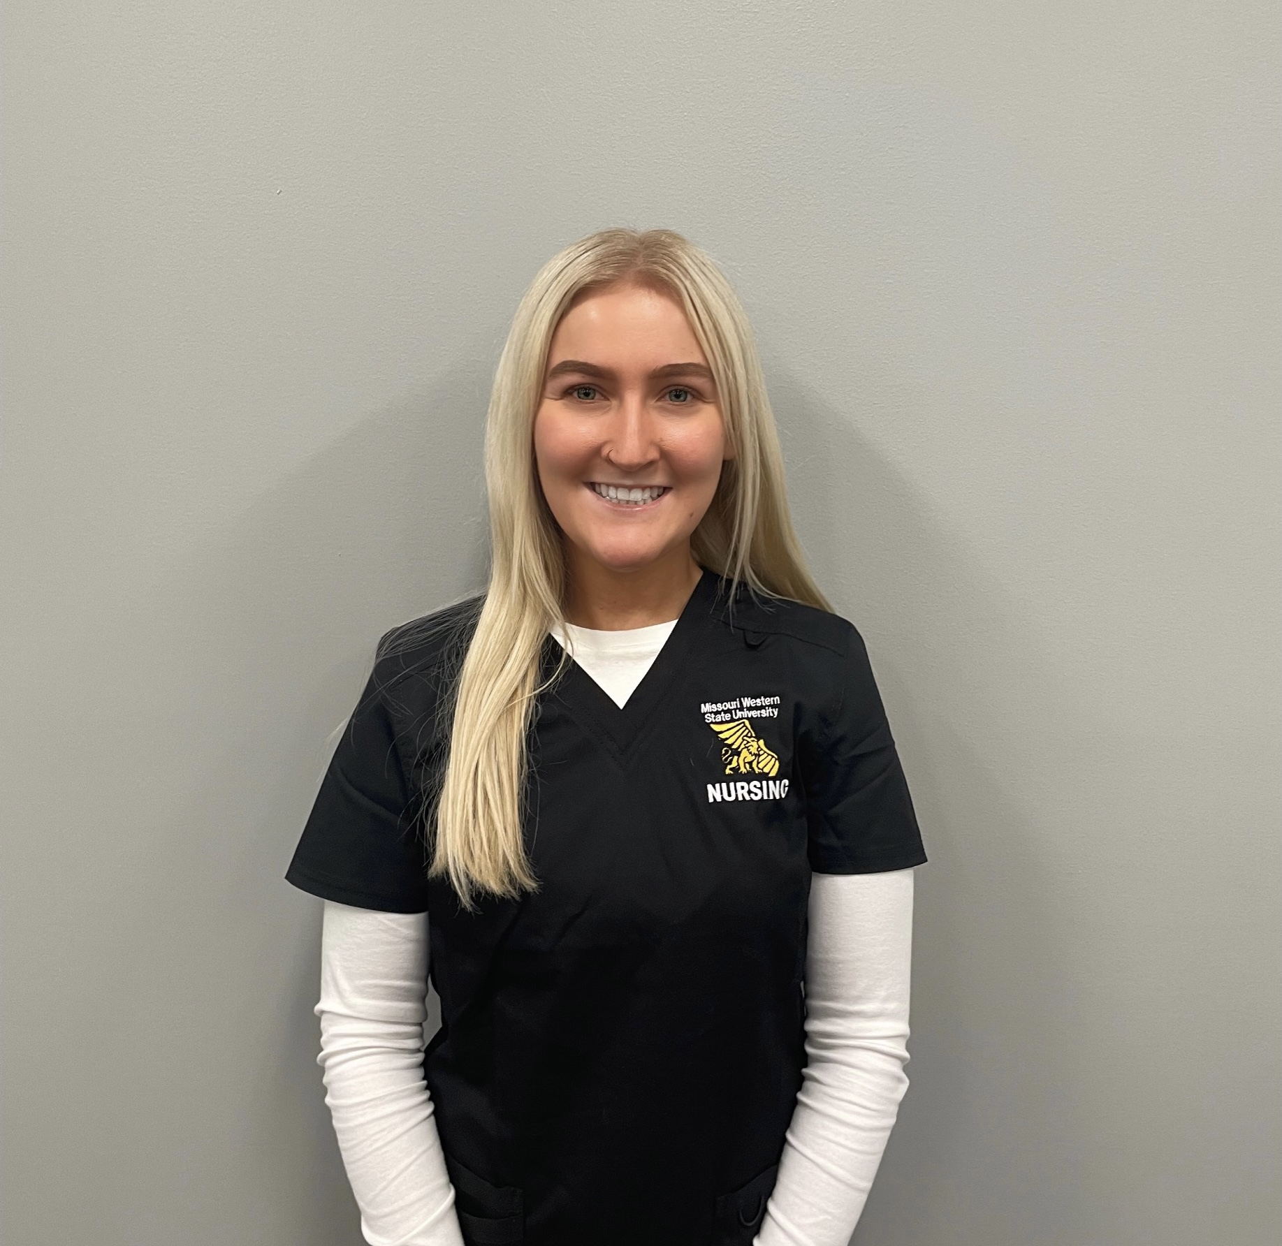
Kylie Jae Gardner
Major: Nursing
Plans After Graduation: Working at Liberty Hospital as an RN on the oncology unit.
Most Memorable Moment: The friendships that I made.
Advice: Believe in yourself because the time goes by faster than you think.

Slide 12
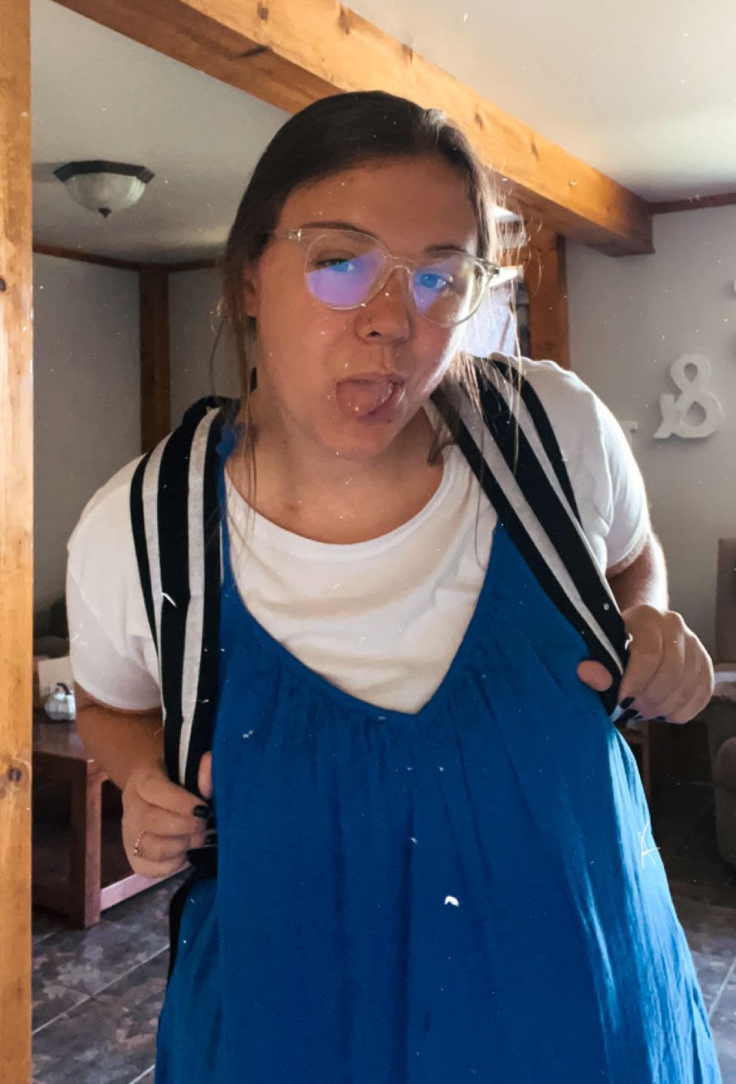
Sumer Green
Major: Elementary Education
Plans After Graduation: Teach fifth grade math at Hosea Elementary School.
Most Memorable Moment: Taking an honors course where she was pushed out of her shell and realized she could be a teacher.
Advice: Take in all the learning opportunities as possible and commit to lifelong learning. College teaches you so much, but even after you graduate, there will always be new things for you to learn as long as you are open to them.

Slide 13
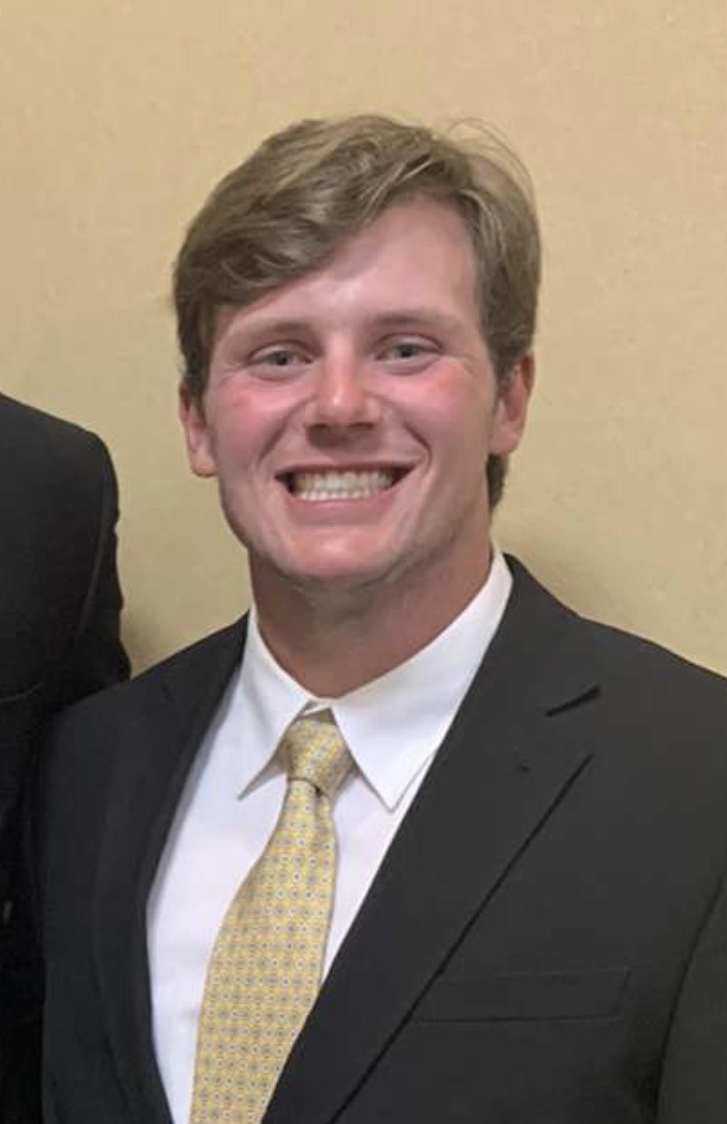
Zachry Hanlan
Major: Physical Education
Plans After Graduation: Play one more year of baseball and then pursue Physical Therapy school.
Most Memorable Moment: Watching movies in my colloquia class over John Wayne and John Ford.
Advice: Make sure you keep a written schedule or planner so you can always stay organized and on top of your work.
Golden Griffon Scholarship recipient

Slide 14
Danielle Hayden
Major: Biology

Slide 15
Logan Hovey
Major: Biology
Plans After Graduation: Attend medical school.
Most Memorable Moment: Dr. DesAutels class on free will.
Advice: Take advantage of getting to apply for your classes early.

Slide 16
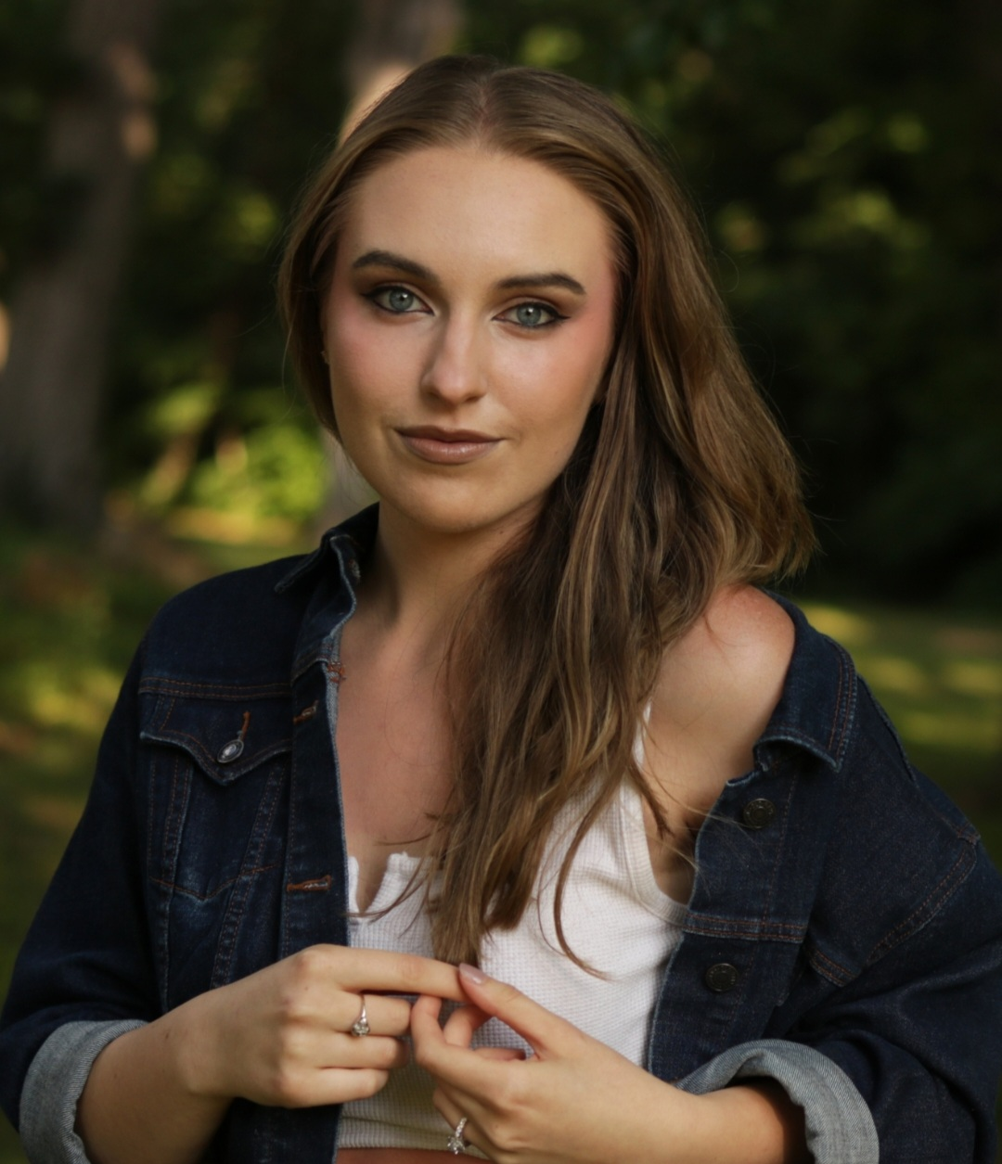
Gabriele King
Major: Studio Art
Plans After Graduation: Work as an Expressive Therapist as well as a Medical Support Technician in Sioux Falls, South Dakota.
Most Memorable Moment: The completion of the program.
Advice: Don't rush your way through the program, especially not your colloquia. Some of the most fulfilling classes turn out to be the ones you would least expect.

Slide 17
Barak Mareske
Major: Digital Animation

Slide 18
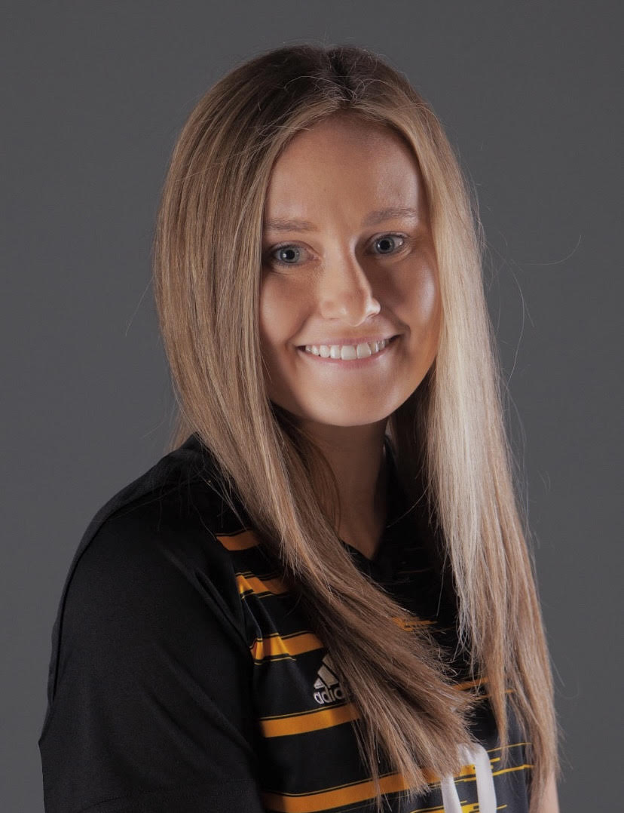
Kylie Mathis
Major: Accounting and Finance
Plans After Graduation: I will be working as a tax associate at FORVIS, a CPA firm in Kansas City. I will be pursuing my CPA license as well.
Most Memorable Moment: Visiting a nursing home in St. Joseph with an emotional support dog as part of my colloquium course.
Advice: Keep working hard. Challenging yourself is how you get the most out of your education.

Slide 19
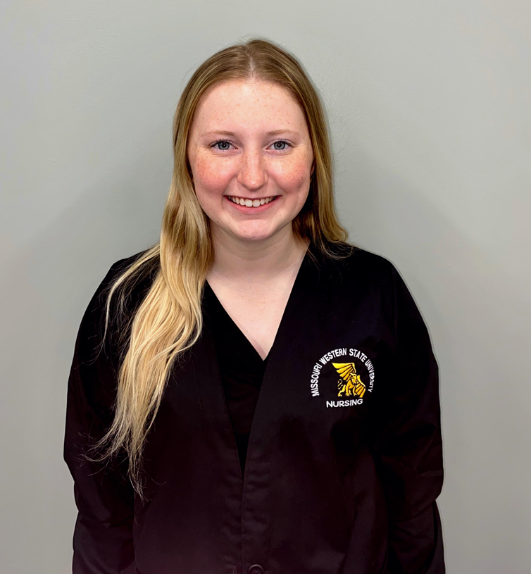
McKenna M. Mavel
Major: Nursing
Plans After Graduation: Accepting a job as a nurse in the emergency department at Liberty Hospital.
Most Memorable Moment: When an emotional support dog was brought in to class and we discussed the benefits of emotional support animals.
Advice: Lean on your fellow classmates when you need help and make the most of it, it goes by fast!
Golden Griffon Scholarship recipient

Slide 20
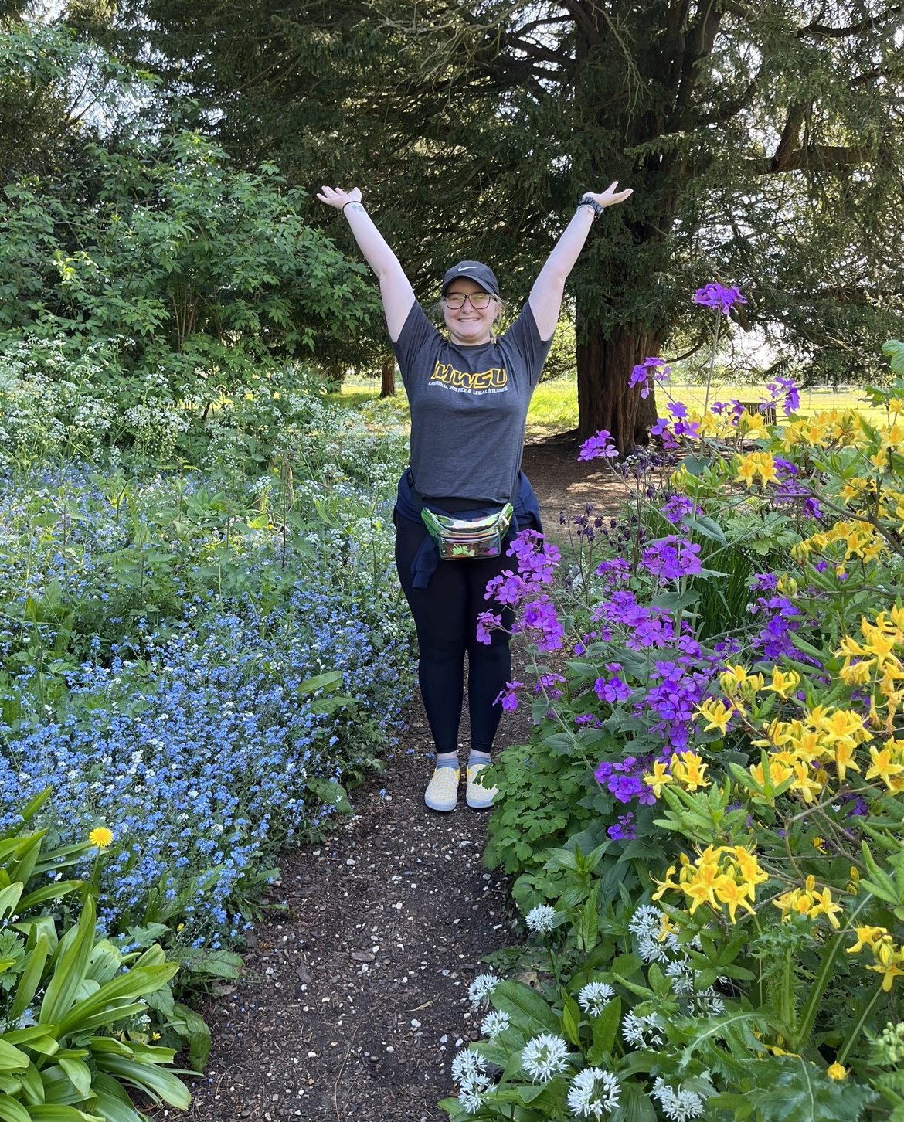
Kylee Shea Meehan
Major: Psychology
Minor: Criminal Justice
Plans After Graduation: Continuing my employment with the Saint Joseph Police Department as a patrol officer.
Most Memorable Moment: Going to the Alpha Chi conference in Austin, TX in spring 2022.
Advice: Take every opportunity for experiences outside the classroom that you can, that’s where the real learning happens!

Slide 21
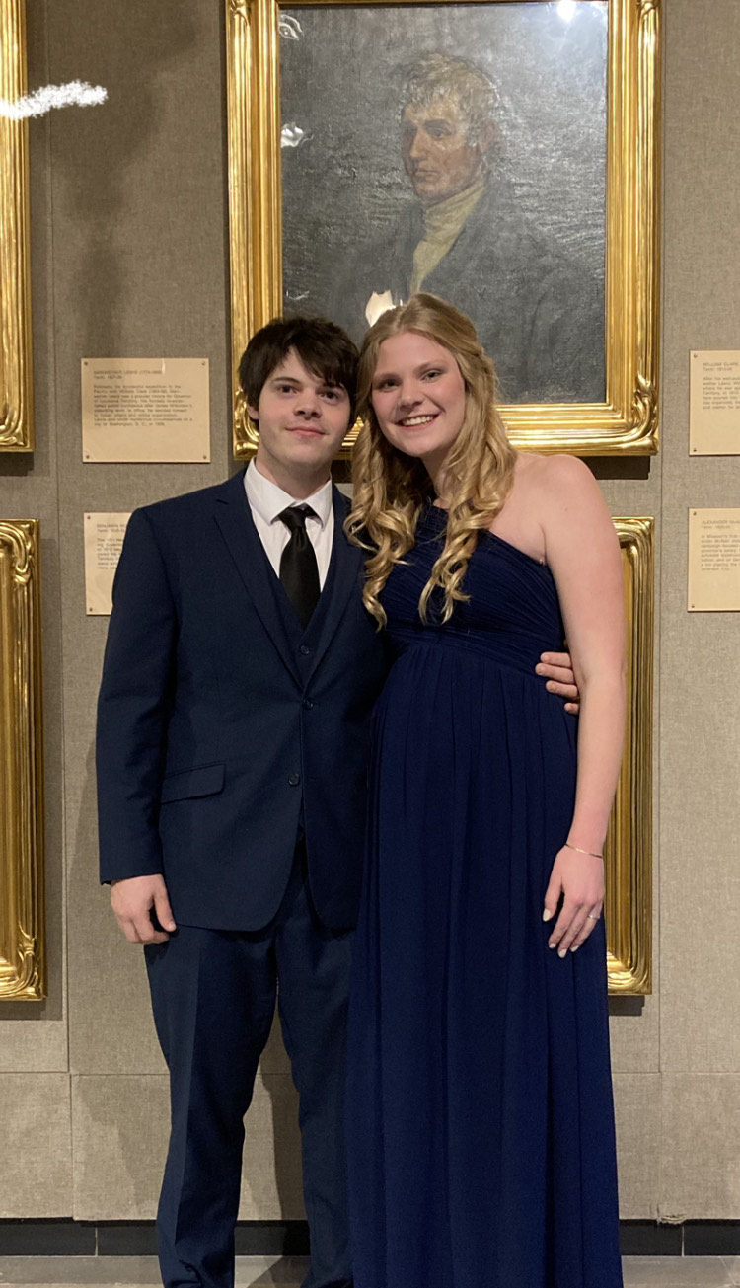
Jordan Miller
Major: Political Science
Plans After Graduation: Find employment in the Missouri House of Representatives as a legislative assistant, analyst, or other support staff position.
Most Memorable Moment: The day I met the woman, who is now my wife, at a Student Honors Organization meeting.
Advice: Don’t put things off for too long, but don’t worry about them too much either.
Golden Griffon Scholarship recipient

Slide 22
Hannah Shoemaker
Major: Biology
Minor: Technical Communication

Slide 23
Madison Spath
Major: Performing and Cinematic Arts
Golden Griffon Scholarship recipient

Slide 24
Jude Stapf
Major: Chemistry
Plans After Graduation:
Most Memorable Moment:
Advice:

Slide 25
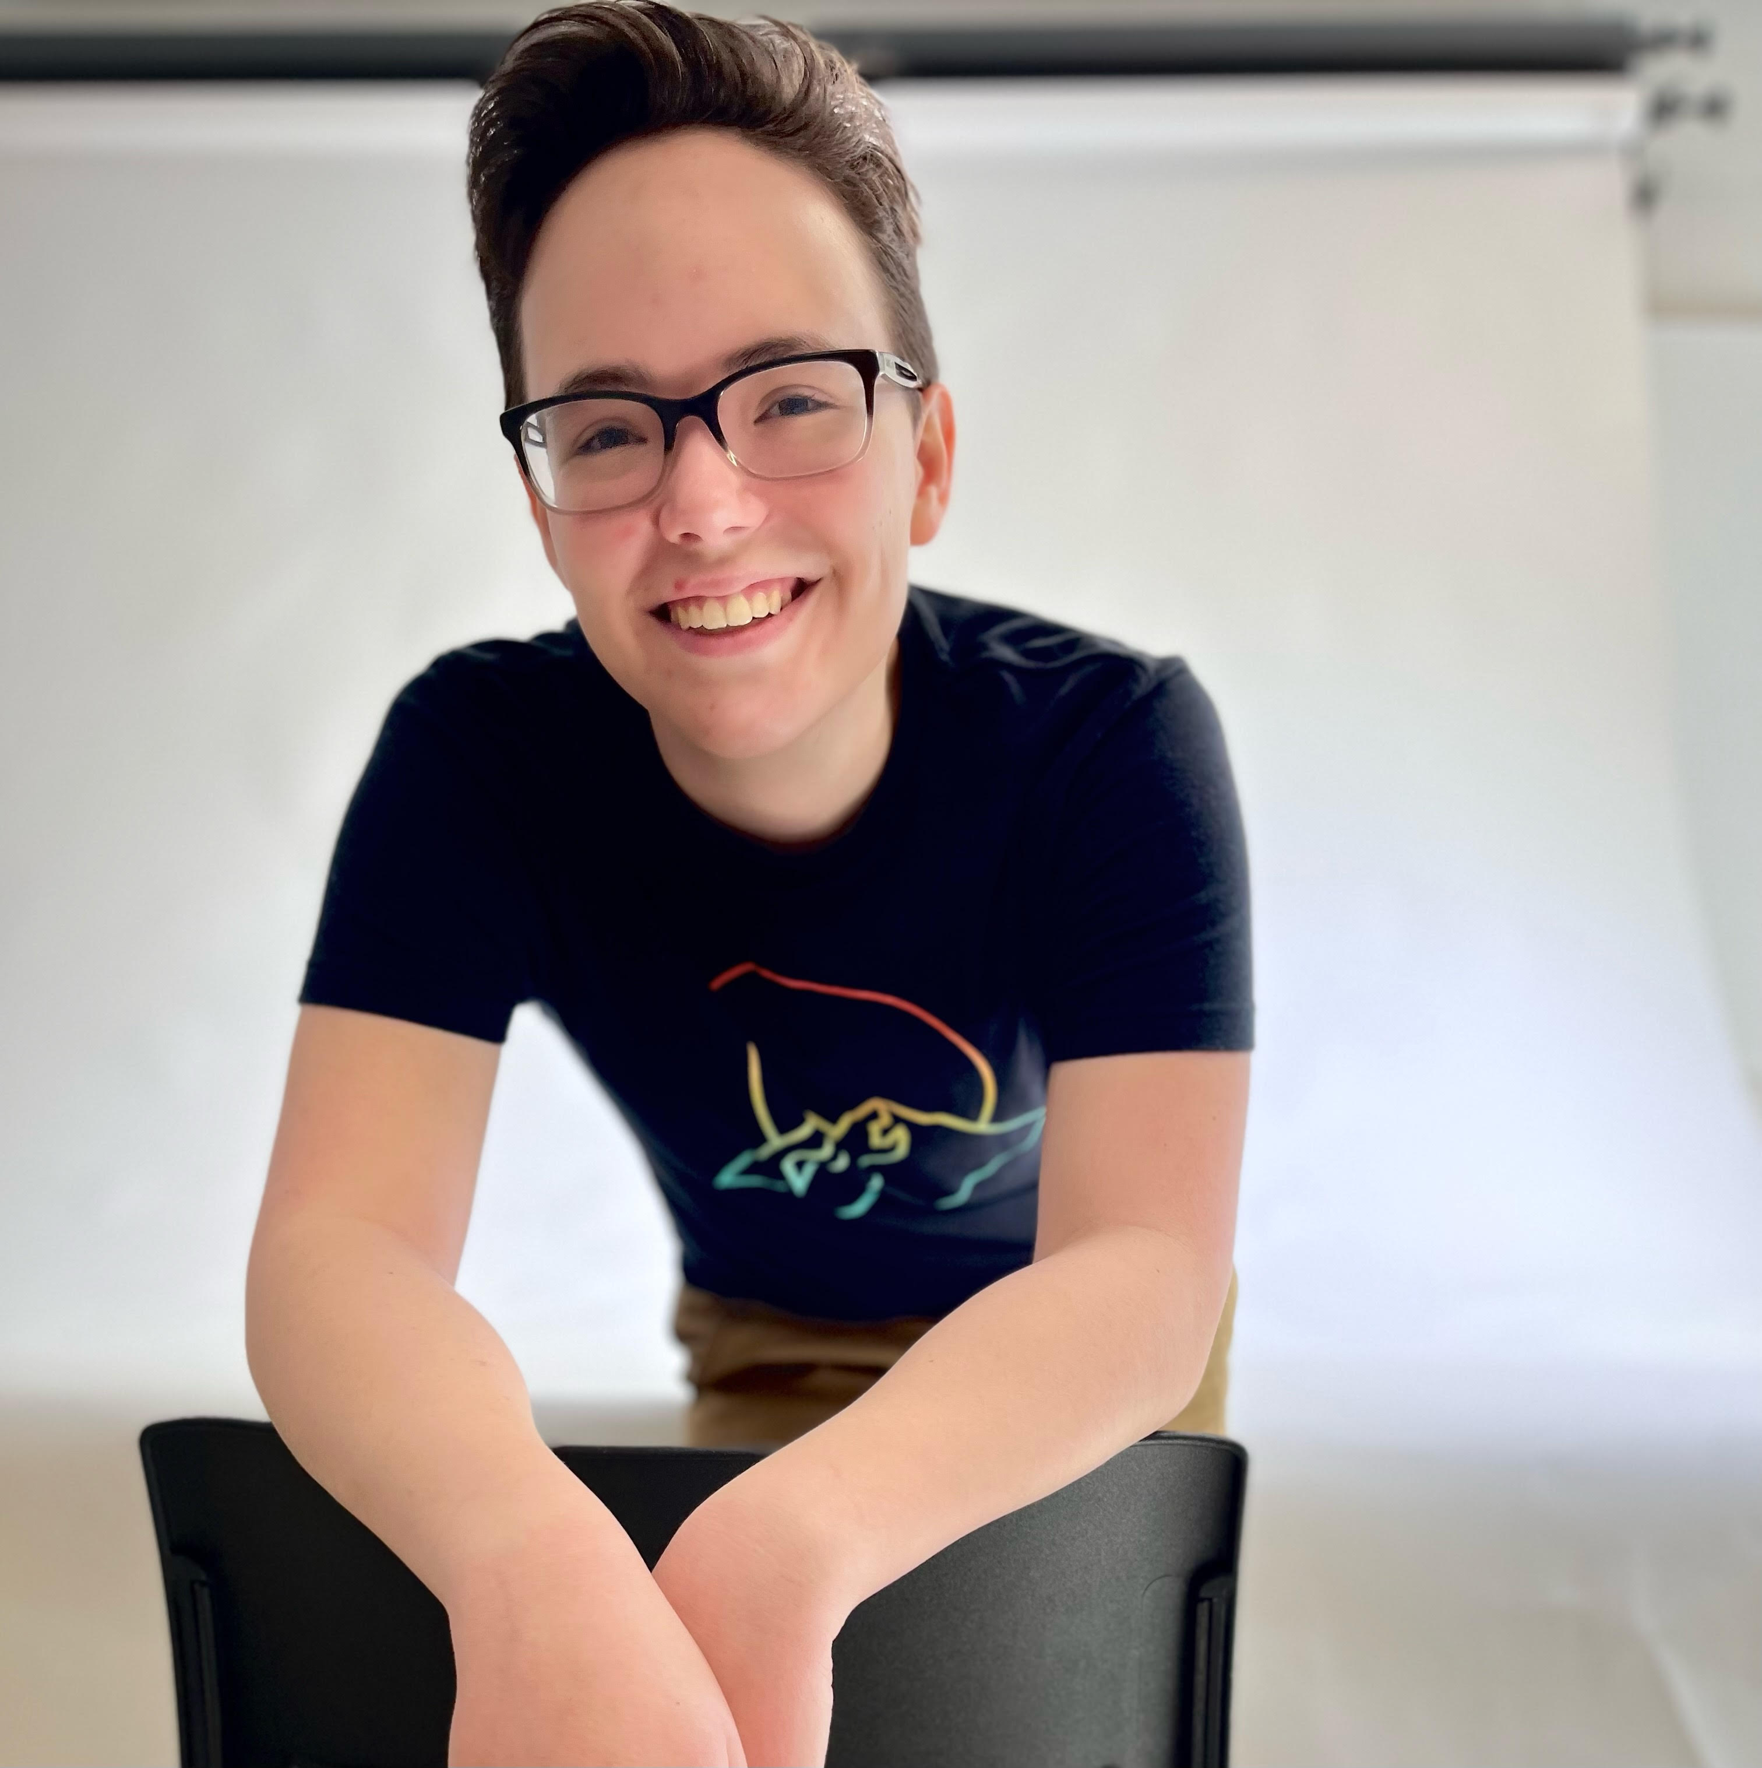
Mo Tajchman
Major: Graphic Design
Plans After Graduation: Look for a graphic design job near Kansas City.
Most Memorable Moment: During their honors oral communication class when everyone presented their ideas and had friendly discussions on certain topics.
Advice: Complete the requirements early and to make friends in your honors classes.
Golden Griffon Scholarship recipient

Slide 26
Tori Willis
Major: Psychology
Minor: Childhood Studies
Plans After Graduation : Look for a graphic design job near Kansas City.
Most Memorable Moment: The discussions that came up during my colloquia classes.
Advice: Showing up to class is so important during the program and vital to your grades.

Slide 27
Bowyn Dale Ziebarth
Major: Biochemistry and Molecular Biology, and Chemistry
Plans After Graduation: Attending graduate school at Mizzou in Columbia, Missouri.
Most Memorable Moment: Receiving my Golden Griffon pin my first semester and my certificate of completion after finishing the program requirements.
Advice: Use your time in the program to explore the unique classes and have fun in them.
Golden Griffon Scholarship recipient

Slide 28
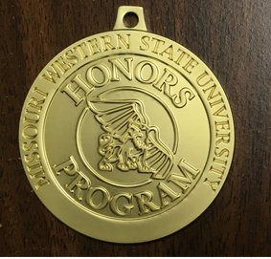
Majors Honors

Slide 29
Konner Larkin
Major: Wildlife Conservation and Management
Minor: Earth and Environmental Science Geography
Plans After Graduation: Work at DeSoto National Refuge as a biological technician and then get a position with the U.S. Fish and Wildlife Service.
Most Memorable Moment: The field trip to the Ozark Underground Lab where I got a tour of the Tumbling Creek Cave.
Advice: Enjoy all the time and people you meet because it goes by fast! Don’t be afraid to take risks or any new opportunities that may present themselves.

Slide 30
Outstanding Contributions to the Honors Program
Congratulations,
Dr. Lane DesAutels

Slide 31
Congratulations Class of Spring 2023!

