Slide 1
Navigating Assessment Waters: Making Data Work for Advancement
Yen To, PhD
Director of Institutional Research & Assessment

Slide 2
Assessment Waters
1970s: Assessment in Higher Ed as a tool to look at ROI started in 1970s
1990s: Student Learning & Accountability focused
2000s: Assessment incorporated into Accreditation entities
Today: Used for Quality Enhancement and Compliance

Slide 3

Choppy OR Calm?

Slide 4

Choppy OR Calm?

Slide 5
Goals of the Workshop
Using Assessment as a tool for Improvement
Avoid common mistakes when assessing.
Use/Develop an assessment schedule to make data work for Advancement

Slide 6

What is Assessment?

Slide 7
  Terminology
Goal: Essential responsibilities or functions
Objective/Outcome: End product (output) or result (predisposition) of an achieved goal.
Measures: Methods (performance indicators) used to demonstrate evidence.
Target (Benchmark): Minimum performance level needed for success

Slide 8
  GOALS
Goal: Essential responsibilities or functions
  Alumni Relations: Grow alumni, connect w/ Institution
  Development: Promote & facilitate relationships w/ supporters for financial/physical good of the institution
  Design/PR: Compliance with standards, effective communication, maintain relationship w/ media and enhance institution's brand
  Foundation: Grow endowment, culture of sustainable philanthropy

Slide 9
  OBJECTIVES
Objective/Outcome: End product (output) or result (predisposition) of an achieved goal.
  Alumni Relations: more involvement of alumni in retention efforts
  Development: securing x% of unrestricted and restricted endowed gifts
  Design/PR: centralized marketing/advertising resources
  Foundation: Increase endowment by $8 million

Slide 10
  MEASURES
Measures: Methods (performance indicators) used to demonstrate evidence.
  Alumni Relations: Total # of Alumni mentors (survey)
  Development: Total $ in unrestricted/restricted endowments (accounting)
  Design/PR: Count, dispersion, & depth of requests/jobs
  Foundation: Public awareness of institution's funding needs

Slide 11
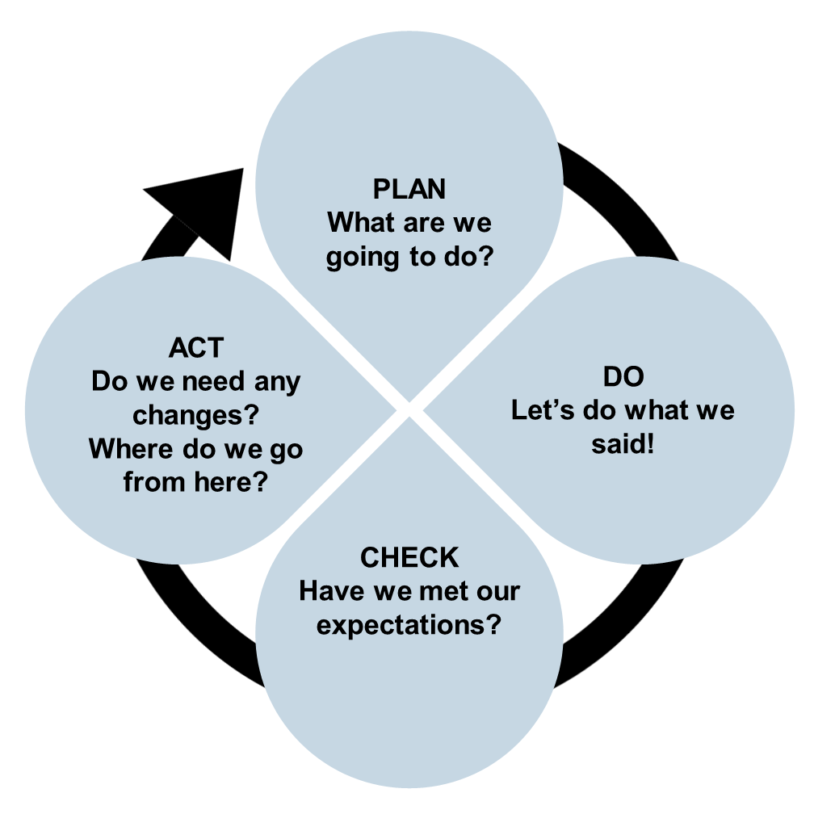
  As an Enhancement Process…
Permits flexibility
  Multiple strategies
  Simultaneous approaches
Data collected are…
  Aligned to objectives/goals
  Success compared to target
When documented..
  Resistant to turnover
  Affords for utility trend data

Slide 12
Challenges
Alumni Relations: Measuring engagement, alumni giving rate
Development: Depth of donor pool, Cost per $ raised
Design/PR: Market reach, using own logos
Foundation: Staffing, endowment assets per FTE enrollment

Slide 13
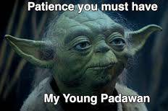
Mindsets to Avoid
Looking for perfection
  Its about progression….getting better!
There is only one correct way to do it
  Needs multifaceted approach
Wanting to do it all
  Eating the Elephant one bite at a time
Giving data too much power
  Context matters
Writing for accreditors/auditors
  Write for those who are likely to read it more often

Slide 14
Planning Errors to Avoid
Starting from a scratch
  The unit has existed prior to the plan so use what you have.
Selecting things that are unmeasurable
  Not being specific. What behaviors/mindset you are looking for?
Not linking to evidence
No paths to follow
  No ownership…who is responsible?
  How will the data be used to inform upon decisions?
  Don’t treat it like a checkbox. Requires same effort but less meaningful.

Slide 15
Best Practices for Data
Addressing outcomes from multiple perspectives.
  Collecting evidence from multiple sources
Coordinate data collection (don’t work in silos)
  Common spreadsheet on shared drive.
  Include your map and target levels for time stamping
  What’s the plan for data use?
Update regularly
  set times for reviews and discussions
Embrace trend data
  When you can’t, document the immediate changes and monitor the progress

Slide 16
Best of Basics
Planning
Make your self an assessment schedule.
  Link events/services to outcomes.
  When will data be reviewed and by whom?
  What will the data be used for?
    Informative ≠ Meaningful
Reporting
Document unit decisions and data use.
  What data was used to make which decision?
  Preserve unit history

Slide 17
Assessment Schedule
Unit Outcomes | Measures | Collection times | Intended Data Use | When Data are Reviewed | Review by
Operational Example: Stakeholders have anytime, anywhere access to administrative services. Move remaining paper form transactions online with portal infrastructure. | Online Tool utilization; Transaction log for paper forms | Every week | Check feasibility of enhanced processing speeds and the demand for automated services. | Monthly during Unit meetings | Director

Slide 18
Assessment Schedule

Slide 19


Slide 20
Provide reliable financial information
Ensure accurate financial reporting
Information systems management reports
List of safeguarded assets
Communicates policies and procedures
Disseminated plan of Coordinated services
Goal
Outcome
Measure

