Slide 1

Looking at Advancement Through an Entrepreneurship Lens
MIAA advancement conference
Annette Weeks
Director of the Center for Entrepreneurship

Slide 2

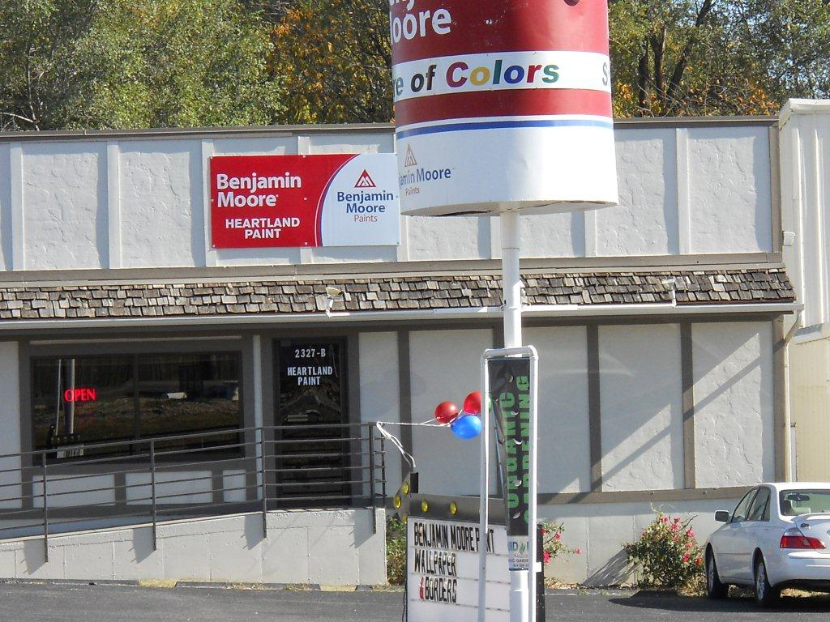

Justin Myers – Owner of Heartland Paint
Justin Myers graduated from Missouri Western with a degree in Business Administration in December 2014 and enrolled in the spring 2015 Applied Entrepreneurship course with the hope of being awarded a franchise opportunity through Missouri Western’s unique entrepreneurship program.

Slide 3
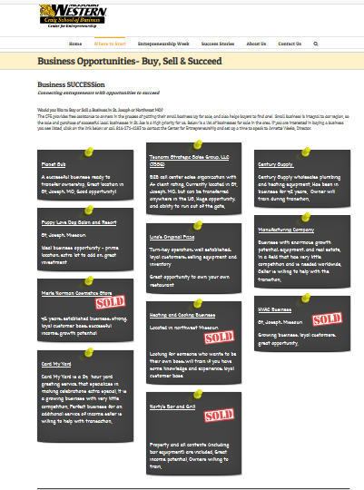

Slide 4
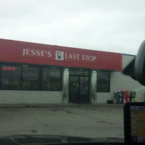


My Entrepreneurial Journey

Slide 5
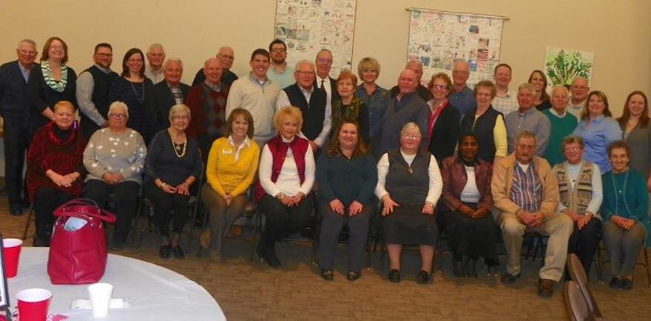

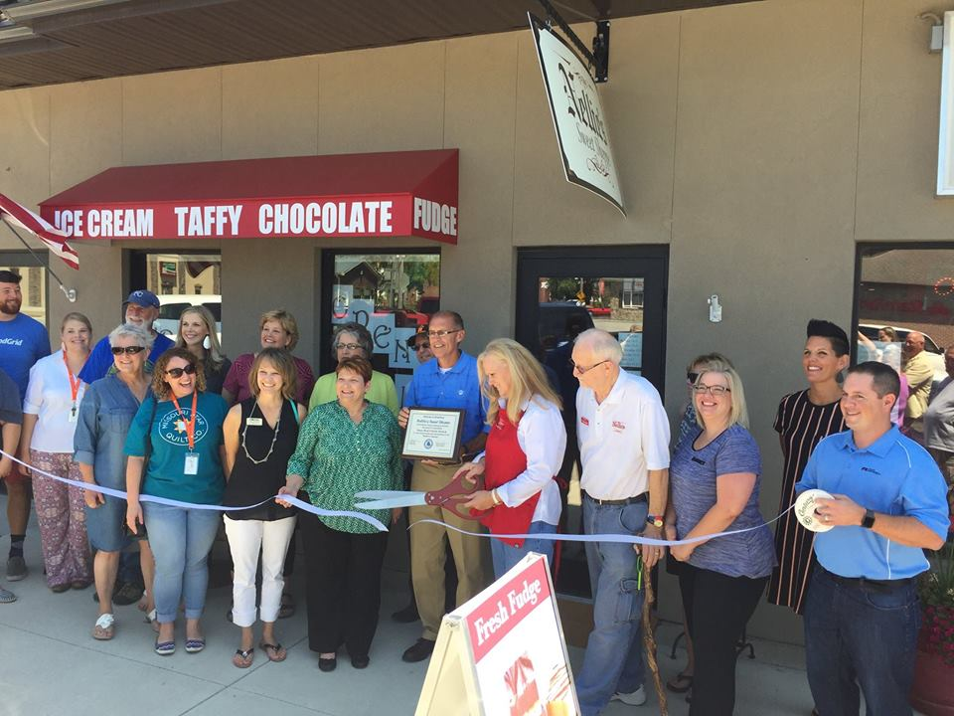


Slide 6
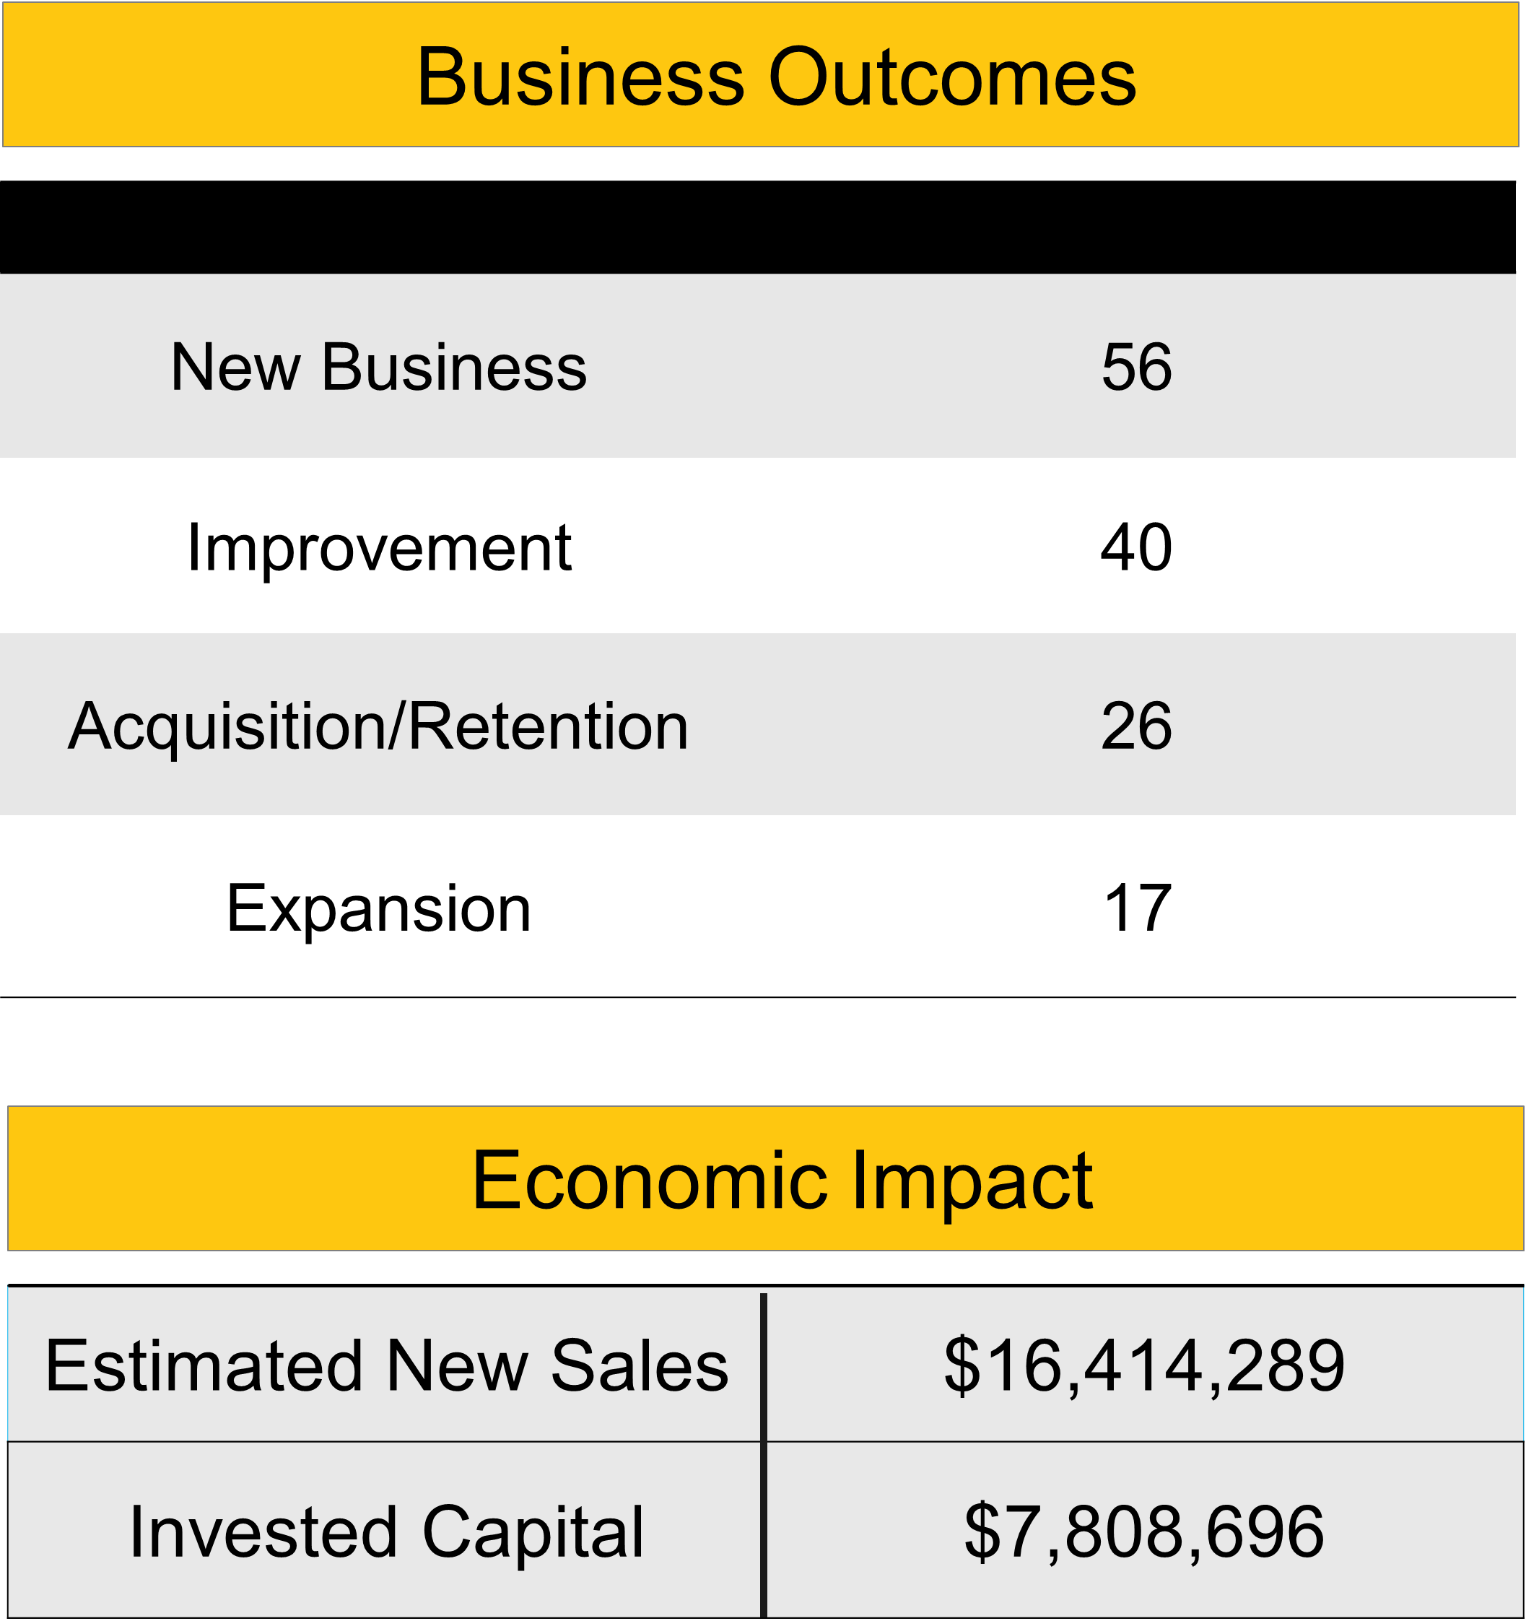
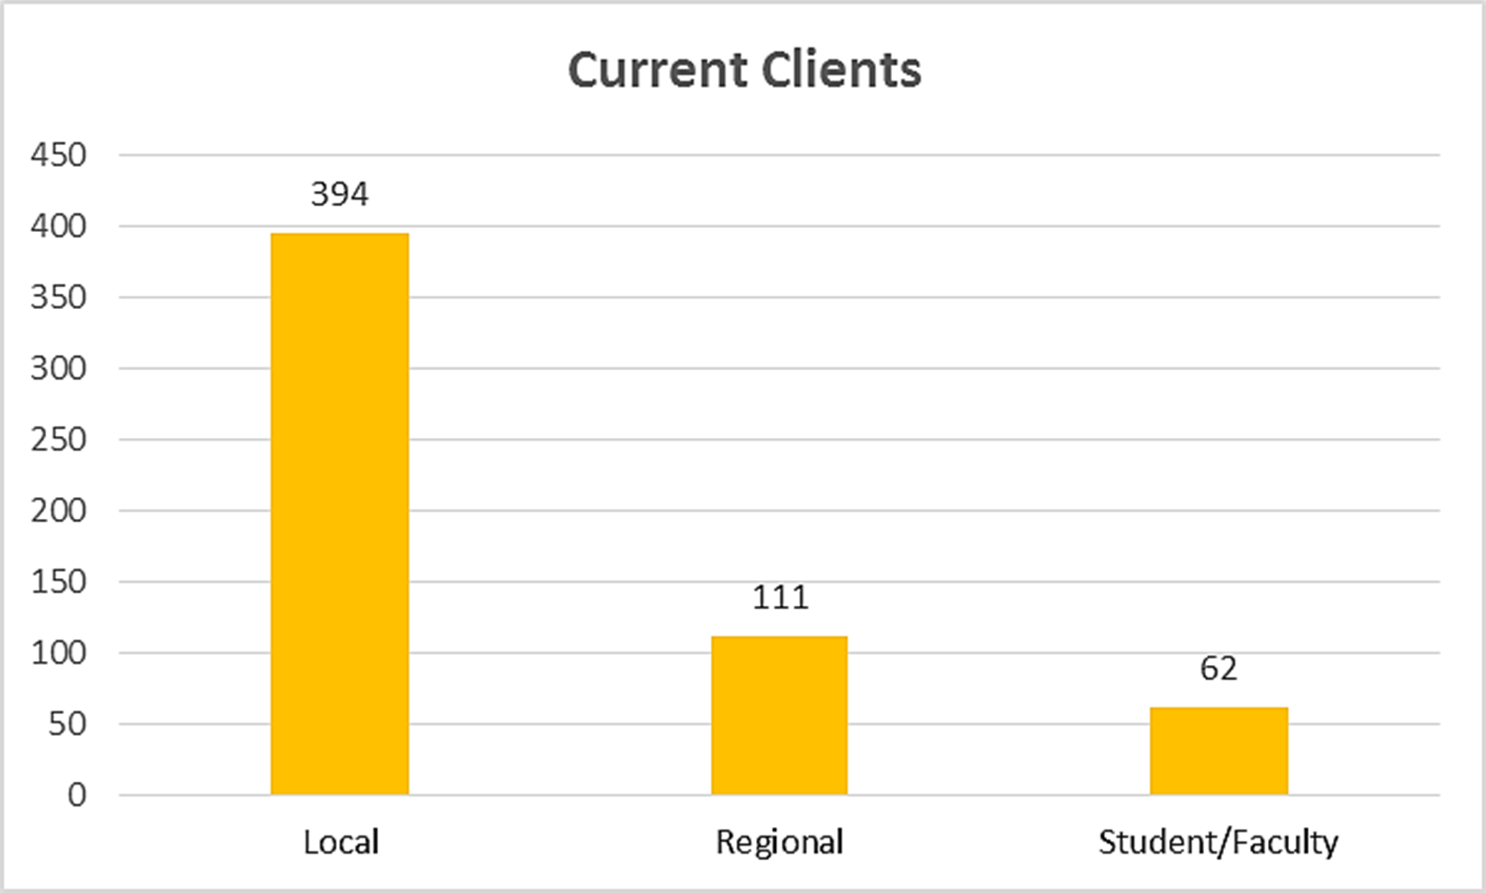
Center for Entrepreneurship

Slide 7

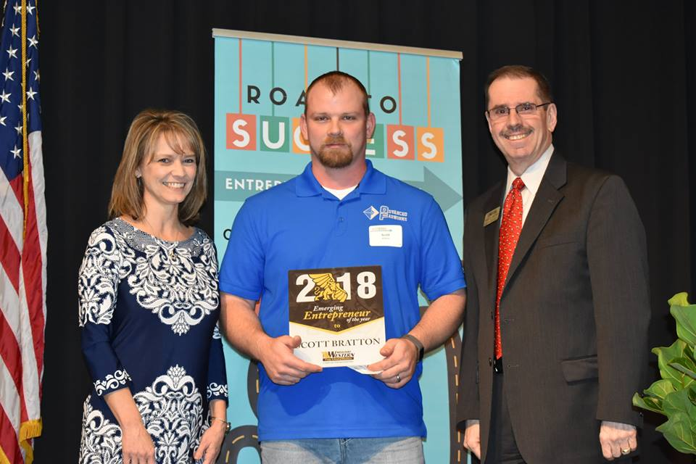

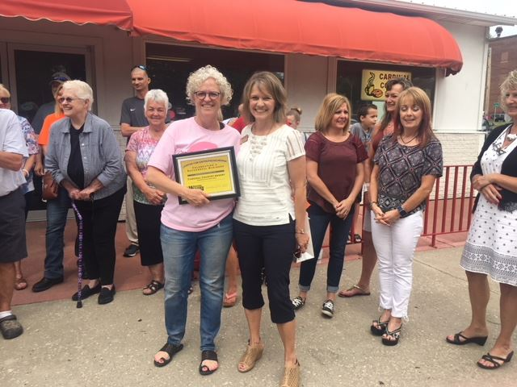


Making Connections in the Community

Slide 8
Entrepreneurs are optimistic enough to believe in themselves, aware enough to see problems around them, stubborn enough to keep going, and bold enough to act again and again. Entrepreneurship is not something you do because you have an idea. It's about having the creativity to question, the strength to believe and the courage to move.
–Jordan Fliegel

Slide 9
INTRAPRENEUR

Slide 10
A person who does entrepreneurial work within an organization
A person who takes hands-on responsibility for creating innovation of any kind, within a business
A person within a large corporation who takes direct responsibility for turning an idea into a profitable finished product through assertive risk-taking and innovation

Slide 11
Stagnation is one of the biggest threats to any organization or company.

Slide 12
Initiative
Self-direction
Risk-taking
Adaptability
Flexibility
Creativity
Innovation
Critical Thinking
Problem Solving
See Opportunities

Slide 13
Entrepreneurial Mindset
Blazing New Trails
Believing in yourself, your mission, and inspiring others to join you in the journey. Have the will, courage and sometimes recklessness to actually do it. Aiming to do something better than it's ever been done before and constantly chasing improvement.
Problem Solver
Approach each problem with a success mindset, which entails seeking out innovative ways to solve a problem by looking beyond what’s already established, and never simply accepting that “this is the way it has to be done.” Looking at it from all angles, coming up with a plan, identify cost, state the outcome.
Risk Taker
You have to get comfortable being uncomfortable. It's not always going to be roses and unicorns. At some point, you're going to run into issues, lose customers and have financial constraints. It's at this point you need to get back on the horse and take another risk, whether it's in the form of a new product, new marketing campaign or a new customer recruitment strategy.

Slide 14
Ability to Listen
The ability to listen, whether it be to the opinions of customers or employees, is also integral to success. You must have the confidence to make your own choices, it is still incredibly important not to become detached from the people whose needs you are trying to meet.
Be a Good Leader.
Leadership is the ability to bring people to a place where they want to follow you, not feel like they are forced to follow you. This takes investing in your network personally. It's not transactional, it's a relationship.
The Power to Pivot
If something isn't working, keeping at it won't make you successful. But changing your approach, changing your model, changing your plans to make it work is.
Accept Failure
An entrepreneur must be able to accept failure. Everyone thinks they can accept failure until they come face-to-face with failing at a major thing they have put everything into. Success does not come without some failure. Learn from it and move on.

Slide 15
Have the Grit
Grit is made up of persistence, passion and resilience. It's the passion to achieve long-term goals, the courage to try again in the face of rejection, and the will to do something better than it has been done before. The most successful entrepreneurs tend to be gritty ones … they do not give up until they exceed their goals. When the going gets tough and they get knocked down, gritty entrepreneurs bounce right back up and try again.
See Opportunity Everywhere
Always looking for new opportunity. It could be developing the business idea, but it could also be seeing the possibilities in the people who can help you grow the idea. This ability to see many options in every situation is critically important.

